Slide 1


Direct management service for high-efficiency waste collection in Ljubljana
Jože Gregorič
Project Manager

Slide 2
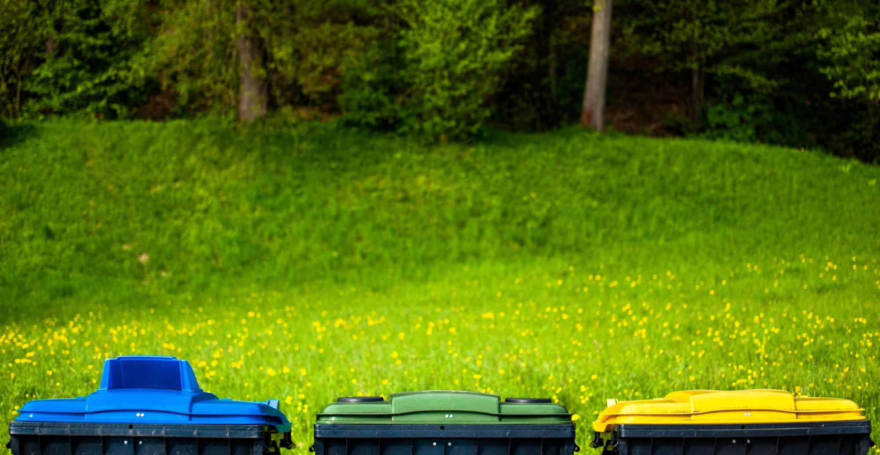
VOKA SNAGA: Main activities
Drainage and treatment of municipal wastewater
Transport of collected waste
Waste treatment -MBT
Separate waste collection
Water supply
Water
Waste
Notes:
- Drinking Water supplay
- Drainage and treatment of waste water
- Take car for green areas an children playground
Clining public areas
collect municipal waste
treated municipal waste
Running reginonal landfill
860 empoyees together,
270 + 90 WM

Slide 3
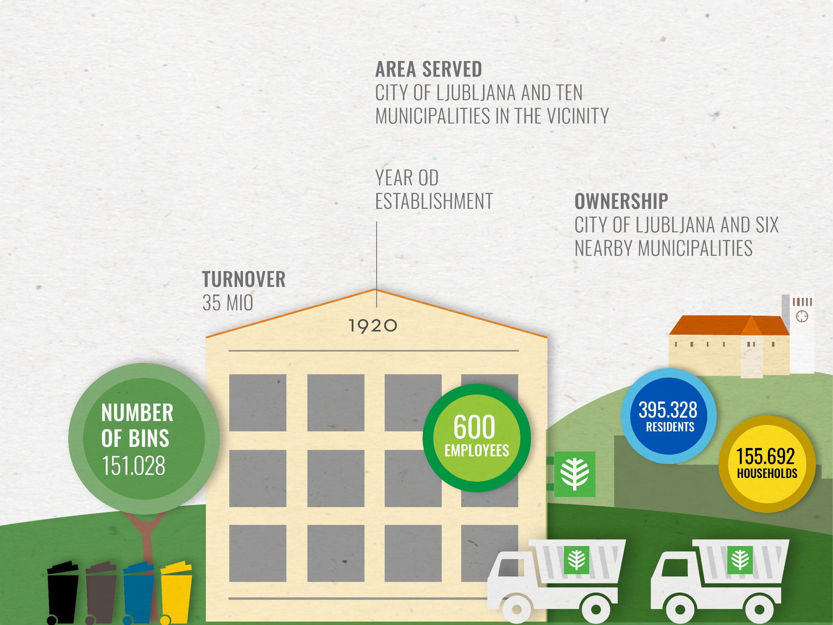


The
public company VOKA SNAGA
WM - department
NUMBER
OF BINS
182.861
410.826
RESIDENTS
270+90
EMPLOYEES
160.127
HOUSE HOLDS
133.078 tons MSW per year
324 kg per person
Notes:
Občina
- Drinking Water supplay
- Drainage and treatment of waste water
- Take car for green areas an children playground
Clining public areas
collect municipal waste
treated municipal waste
Running reginonal landfill
860 empoyees together
Lastniški delež
Mestna občina Ljubljana
87,32%
Občina Medvode
3,84%
Občina Brezovica
2,76%
Občina Dobrova – Polhov Gradec
2,16%
Občina Škofljica
1,80%
Občina Dol pri Ljubljani
1,26%
Občina Horjul
0,86%
SKUPAJ
100,0%

Slide 4
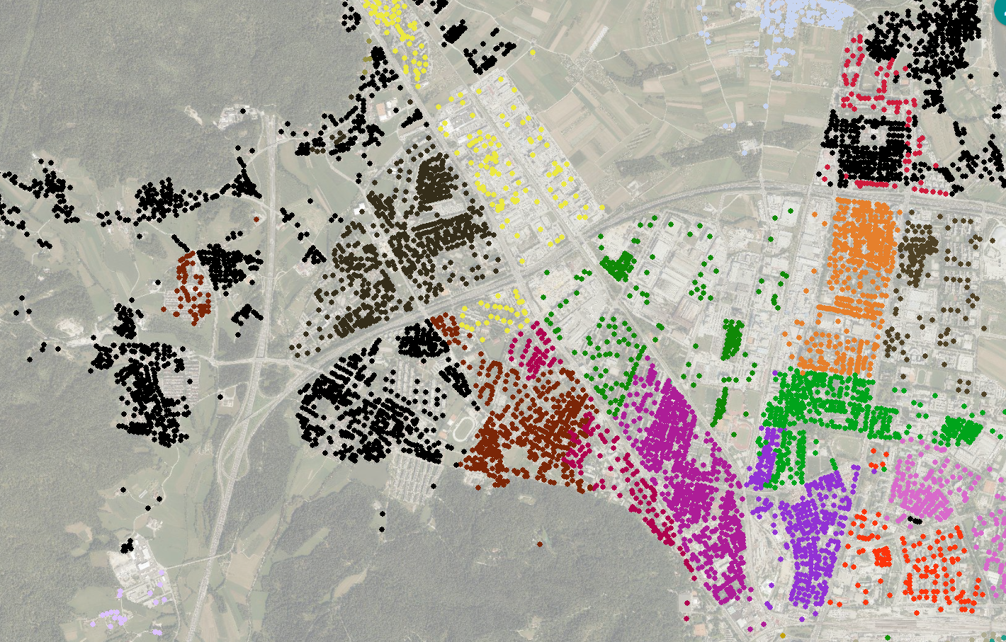
Notes:
Občina
- Drinking Water supplay
- Drainage and treatment of waste water
- Take car for green areas an children playground
Clining public areas
collect municipal waste
treated municipal waste
Running reginonal landfill
860 empoyees together
Lastniški delež
Mestna občina Ljubljana
87,32%
Občina Medvode
3,84%
Občina Brezovica
2,76%
Občina Dobrova – Polhov Gradec
2,16%
Občina Škofljica
1,80%
Občina Dol pri Ljubljani
1,26%
Občina Horjul
0,86%
SKUPAJ
100,0%

Slide 5
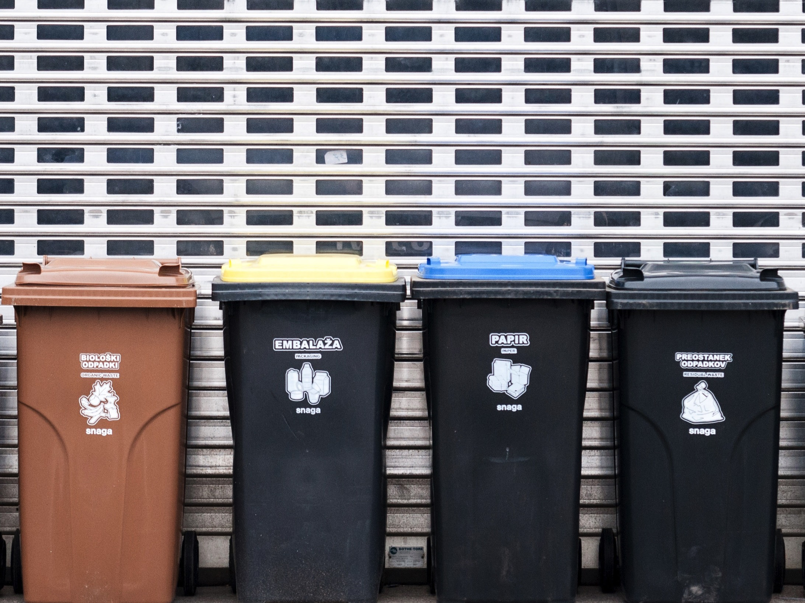
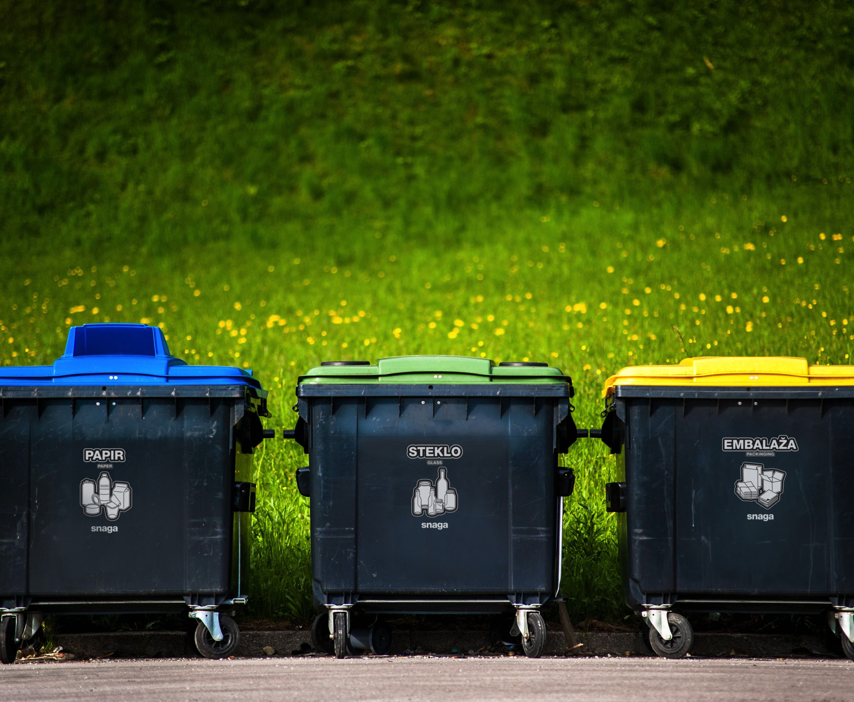
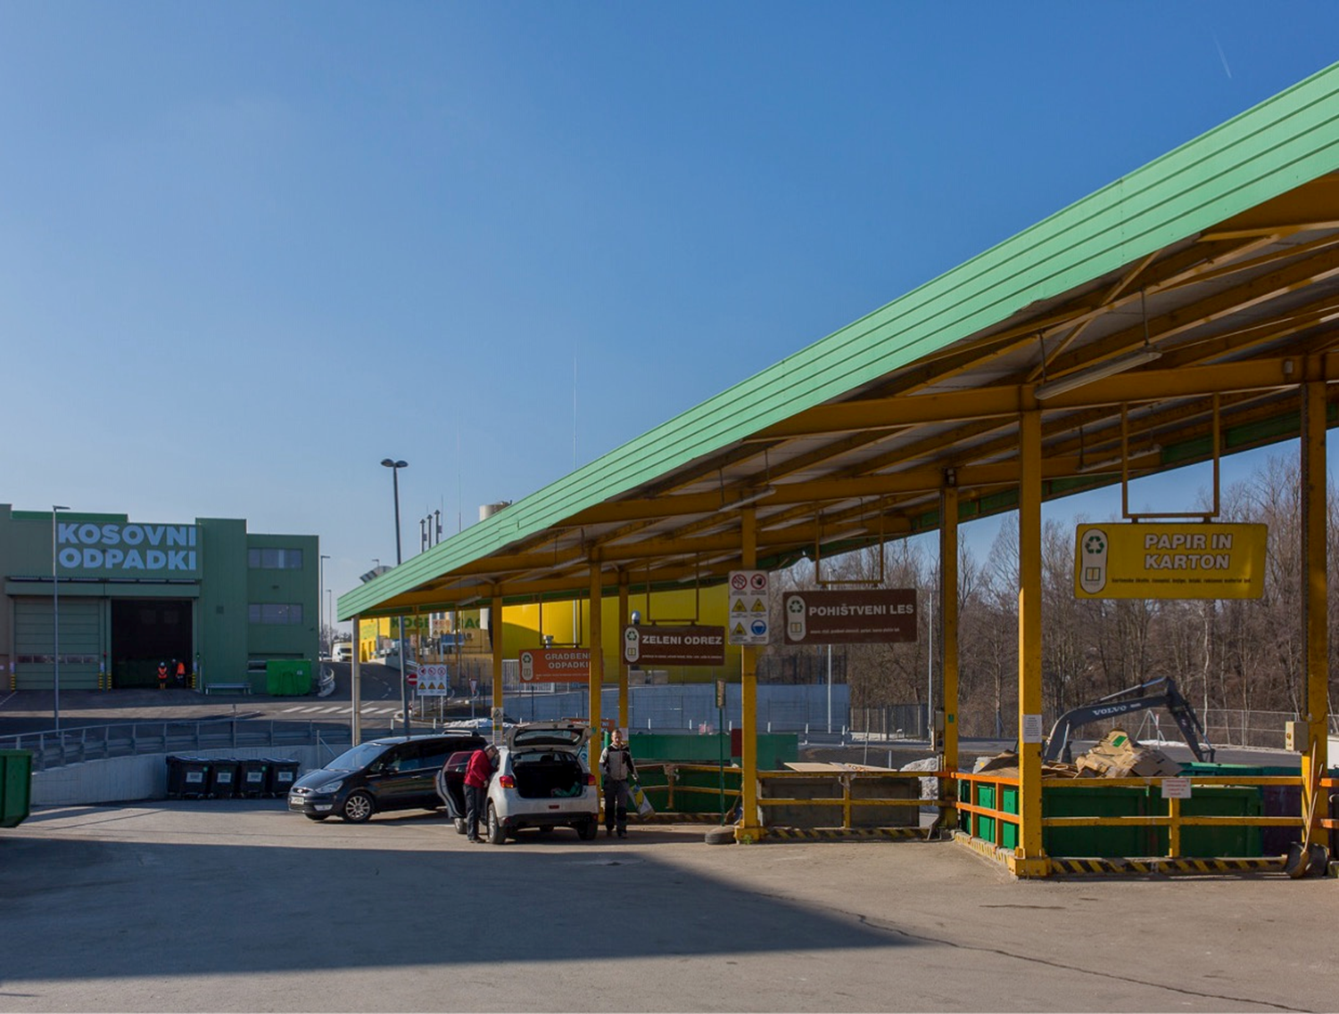
Door to door collection
Organic waste
Mixed plastic, metal and cardboard beverage packaging
Paper and cardboard
Residual waste
Ecological collection sites for packaging.
Waste collection system
Waste collection centres
Bulky, hazardous household waste
Notes:
9 coletion centres, 2+7

Slide 6
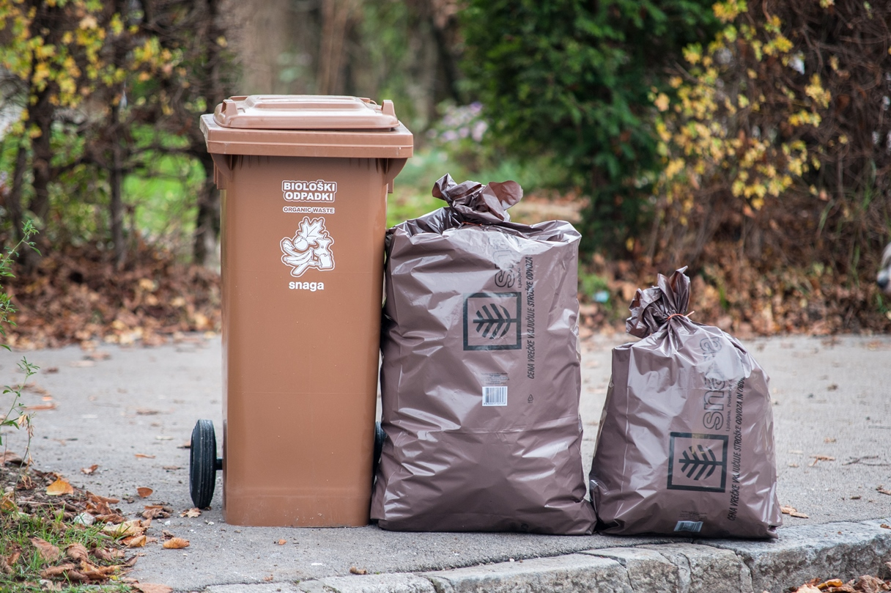
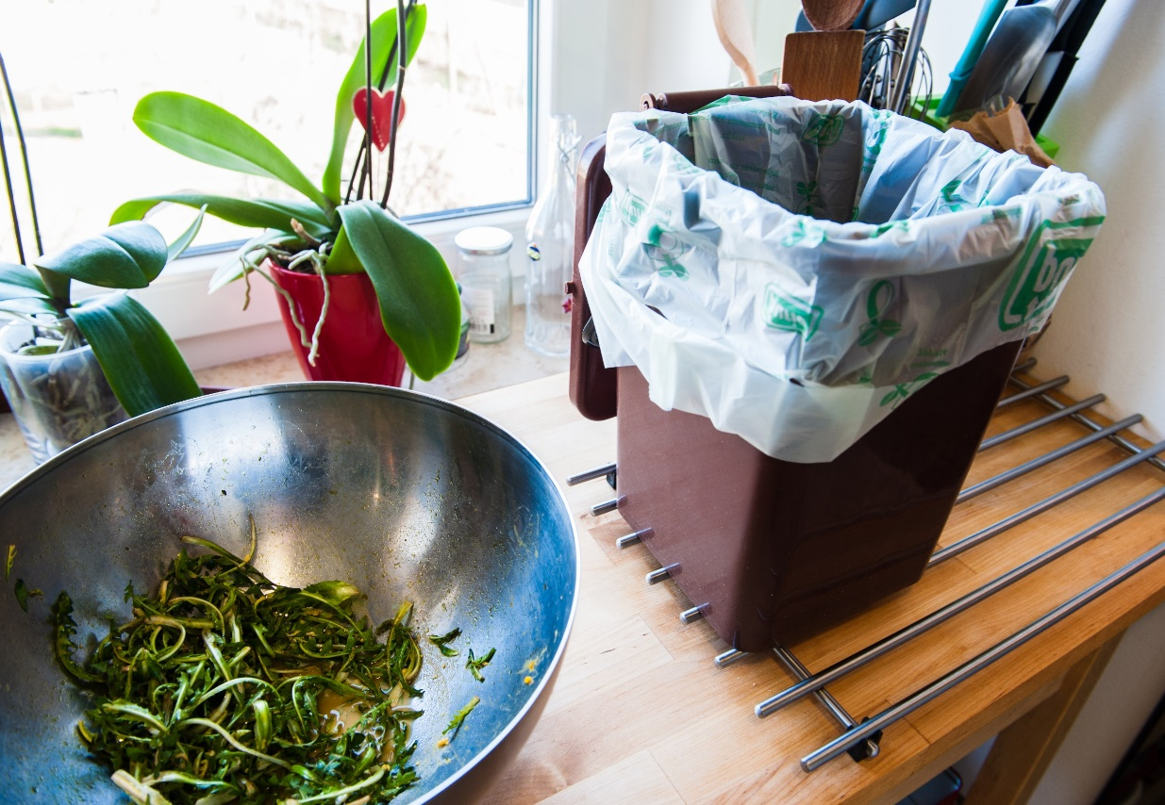
Organic waste collection
66,9 kilos of bio waste per capita per year.
Bio waste represents
20,7 % of all collected waste.
If users occasionally have more bio waste than it can be placed in a bin they can use special bag.
Small BIO bins for every household free of charge.
Notes:
We pay special attention to the separate collection of biological waste.
We believe that well-separated biological waste increases the usefulness of other separately collected waste.

Slide 7
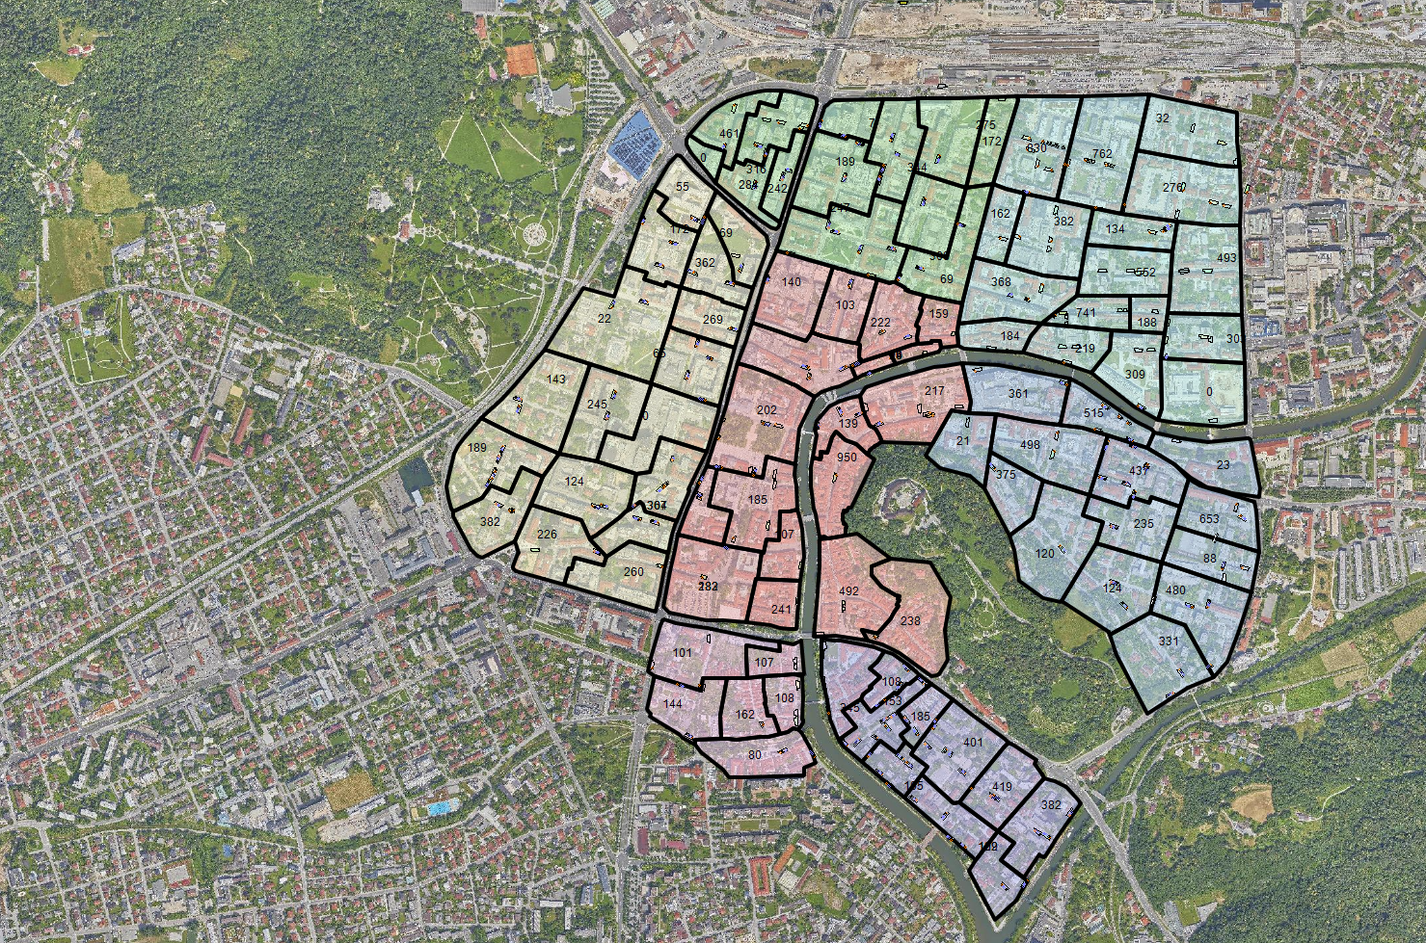
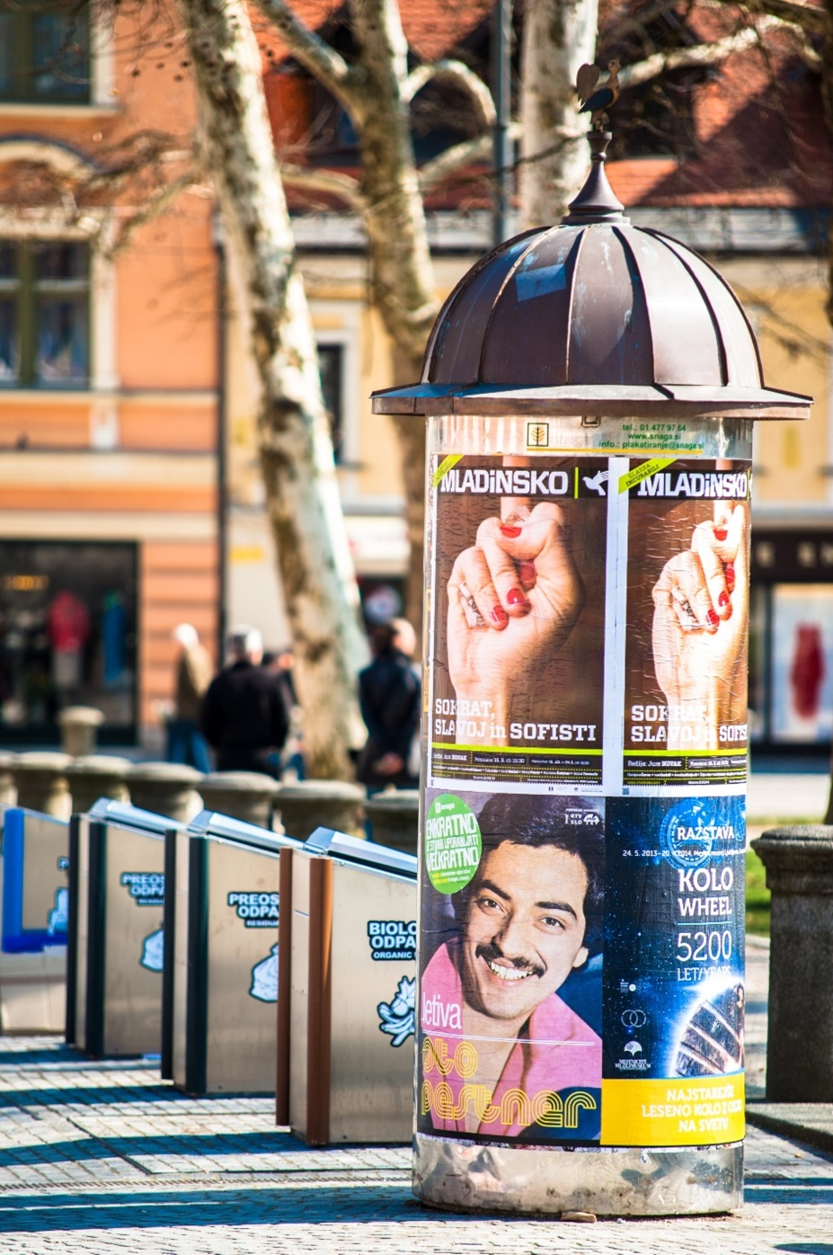
80 underground
collection units for effective and eye-friendly waste disposal in the City centre.
Almost 10.000 bins of all sizes and for all five types of waste
were replaced by underground
units.

Slide 8
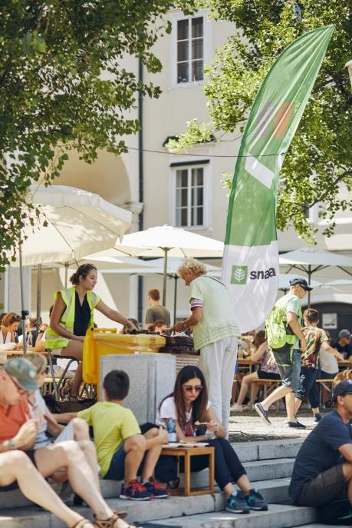

Separate waste collection is established at all public events.
JP VOKA SNAGA takes care of the organization and equipment for separate waste collection at public events.

Slide 9
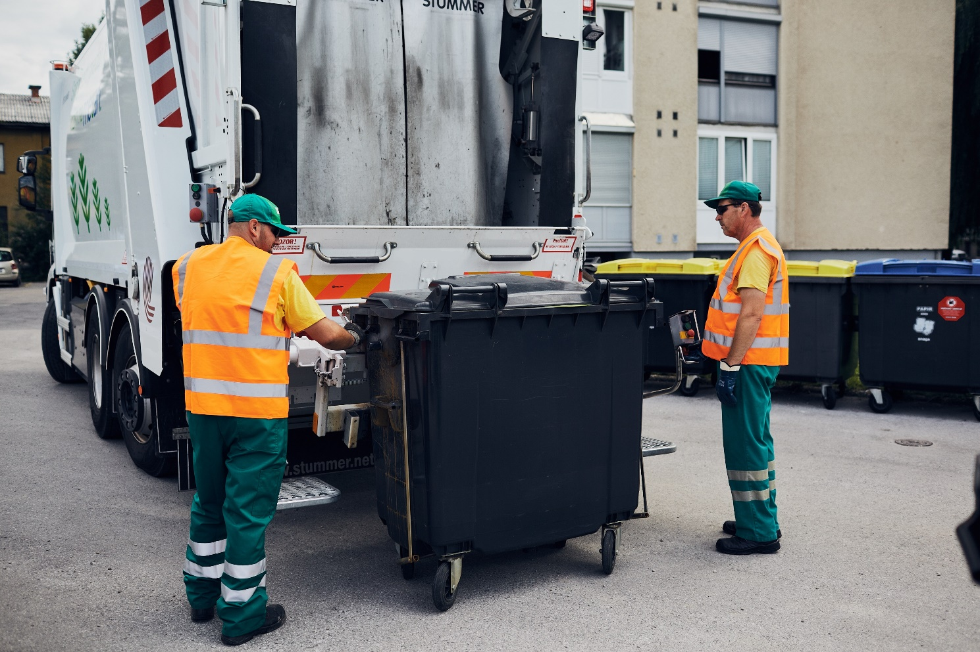
55 waste collection vehicles
3 container washing vehicles
2 vehicles for underground
4 vehicles for bin management
2 van packaging collection in city centre
10 vehicles for industrial and for collection centres
Frequency of emptying
Rest waste & mix packaging – 1w,1/3w, 1/2w
Organic waste - 1w; winter period 14 days
Paper – 1w, 1/2w
Glass – 1/2w
Notes:
10 rotopress for bio waste
3

Slide 10

Quantity of separately collected waste
Quantity of residual waste

Slide 11
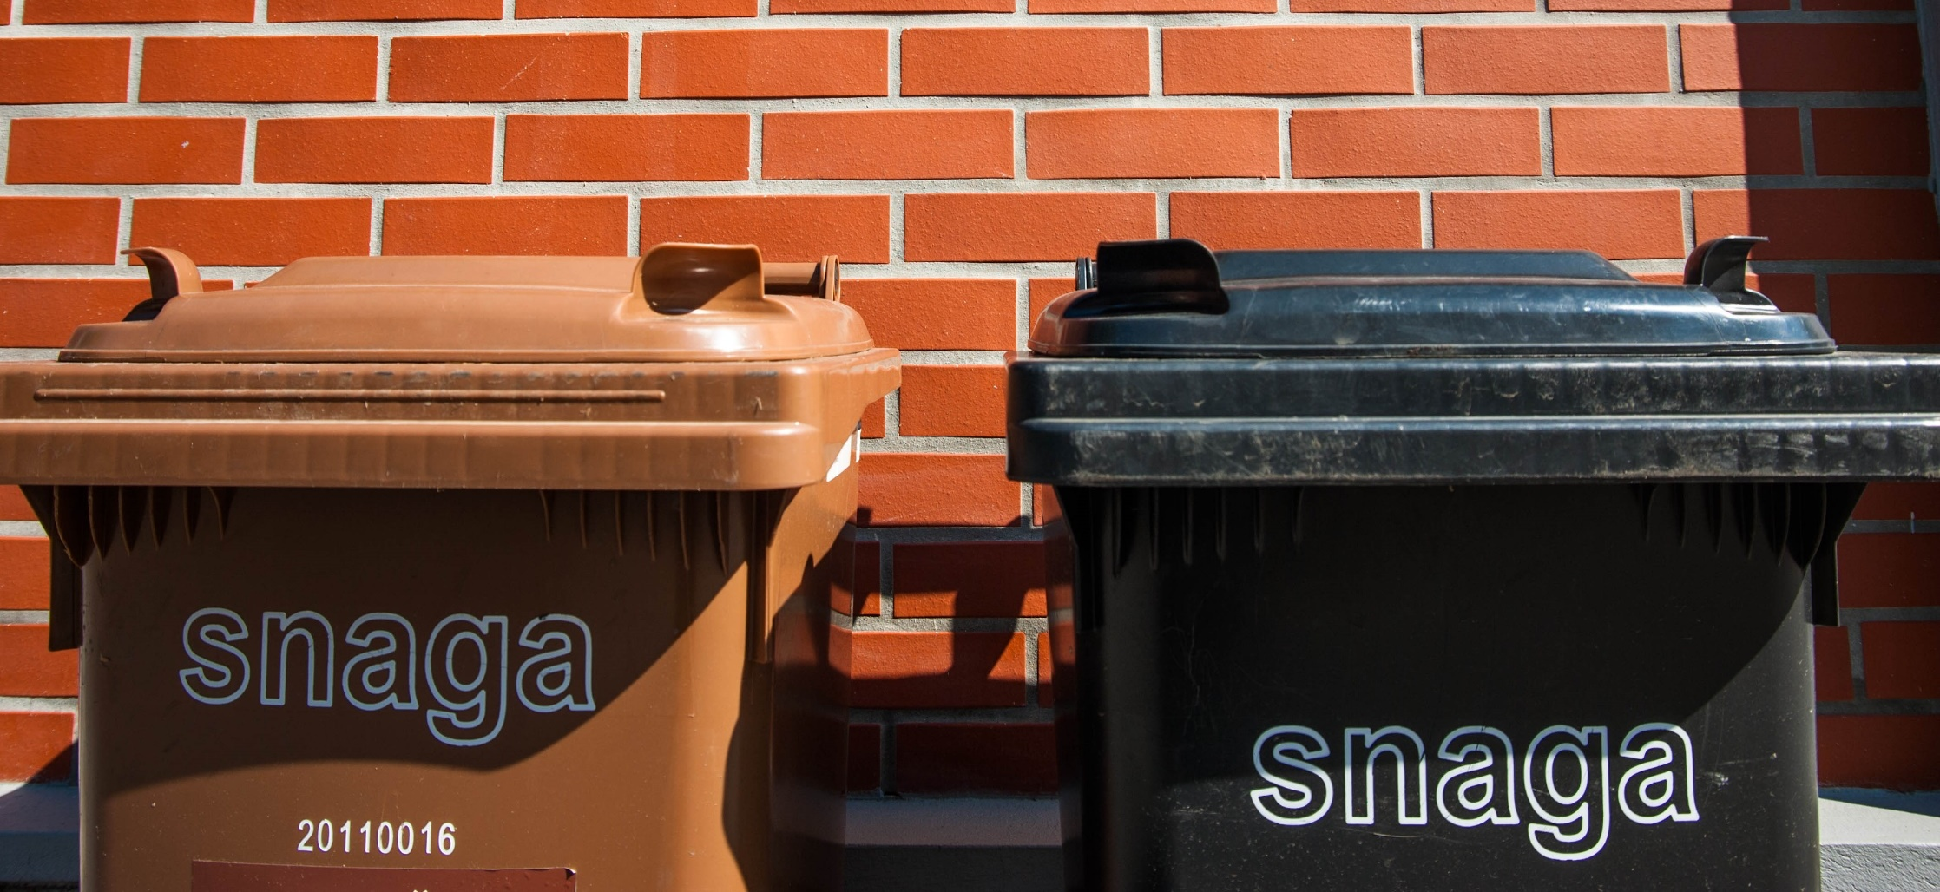
The composition of collected municipal waste in 2024
In 2024 we separately collect 65,8 % of municipal waste.
Recyclability rate – 47,35%*
Notes:
Other materials window glass,, ironnon ferrous metals rubber clothing candles …hazardous waste, green waste, WEEE
Ostali materiali
Ravno steklo,
železo
barvne kovine
gume
oblačila
sveče …

Slide 12
Results of the sorting analysis of mixed municipal waste in year 2024

Slide 13

GOOD SERVICE /
INFRASTRUCTURE
4 PILLARS
OF EFFECTIVE
RESOURCE MANAGEMENT
LEGISLATION
POLITICAL WILL
COMMUNICATION

Slide 14

PAYT system – billing method

Slide 15
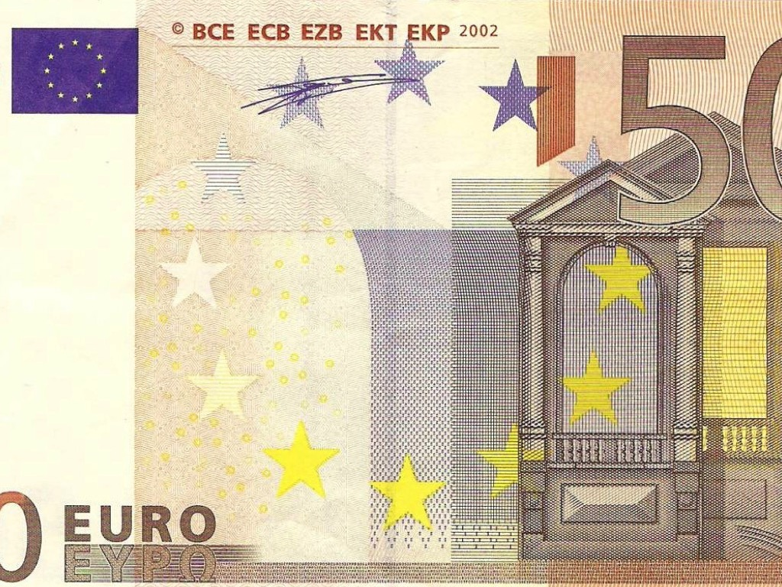
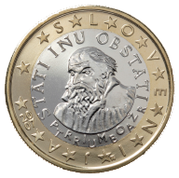
How do we calculate the cost users pay to VOKA SNAGA?
We use the PAYT system. The cost is calculated depending on the size
of the bin for residual waste, and bin for
biological waste; we take the monthly frequency of bin emptying.
An average invoice on a household is
14,47 € per month.
The bill issued covers more than ten WM services:
Door-to-door collection of four waste fractions
providing of waste collection bins;
replacement of damaged bins;
cleaning of bio waste bins;
waste collection at eco-islands;
waste collection at waste collection centres;
collection of bulky items;
collection of hazardous household waste;
cost of all infrastucture facilities (waste collection, processing and disposal);
waste processing;
waste disposal;
communication;
invoice and billing services, etc.

Slide 16

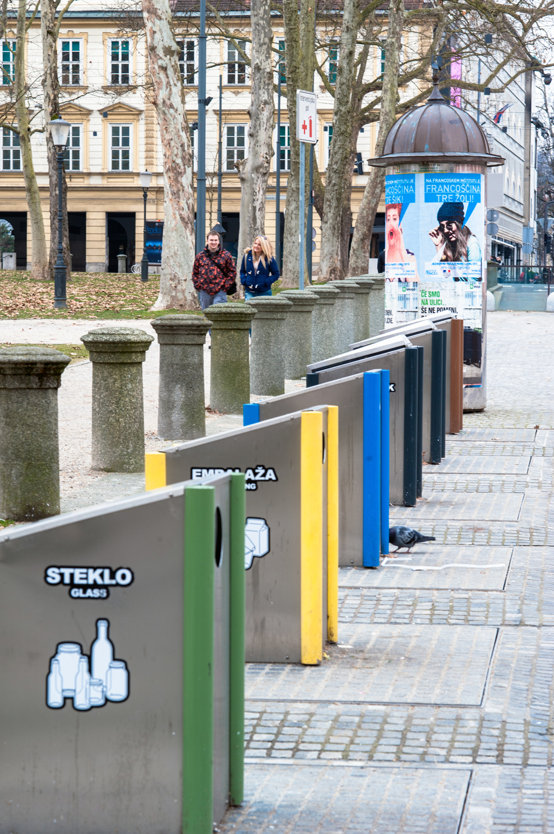
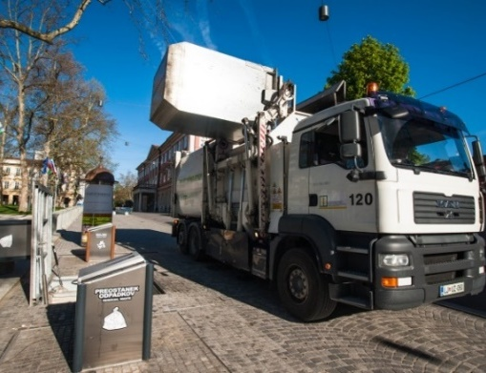
Underground
collection
units
For users of underground collection units, the actual number of disposals per month is billed, but no fewer than six for residual waste and eight for biological waste.
Every active card is billed.

Slide 17

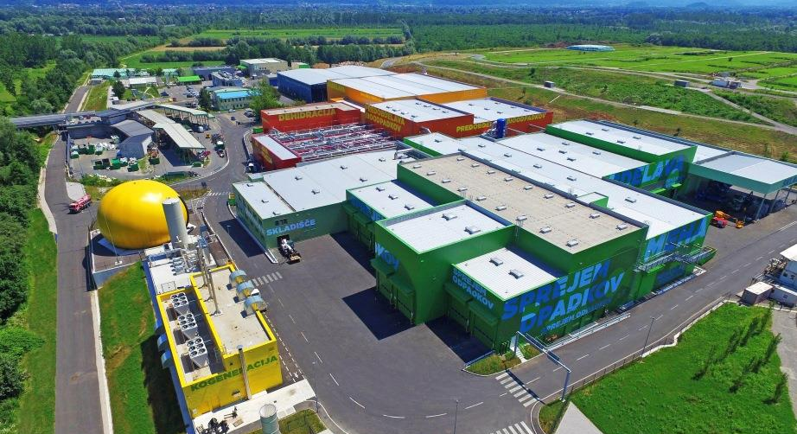
Waste processing in MBT plant - RCERO

Slide 18
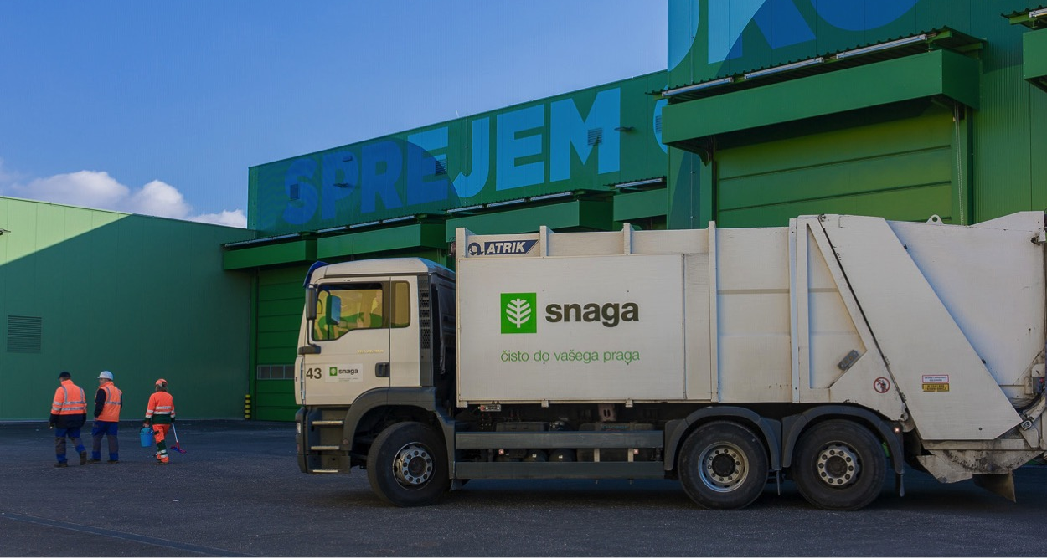
Mechanical-biological facilities for waste processing
Treatment of mixed household residual waste and waste from small businesses, service activities, etc.; 135,000 t/year.
Treatment of separately collected biodegradable household waste;
29,400 t/year.

Slide 19
SIEVING
SORTING
SHREDDING
IN
OUT
Light fraction „A“
Light fraction „B“
Digestate
Recyclable products
Commercial waste (PTSS)
Bulky waste (BHW)
Household waste (MHW, black bin)
Treated wood
LIGHT FRACTION PREPARATION
COMPOSTING
ANAEROBIC FERMENTATION
Residual waste - Landfilling
Biogas / heat / electricity
Compost
Biowaste (BHW)
Yard waste

Slide 20
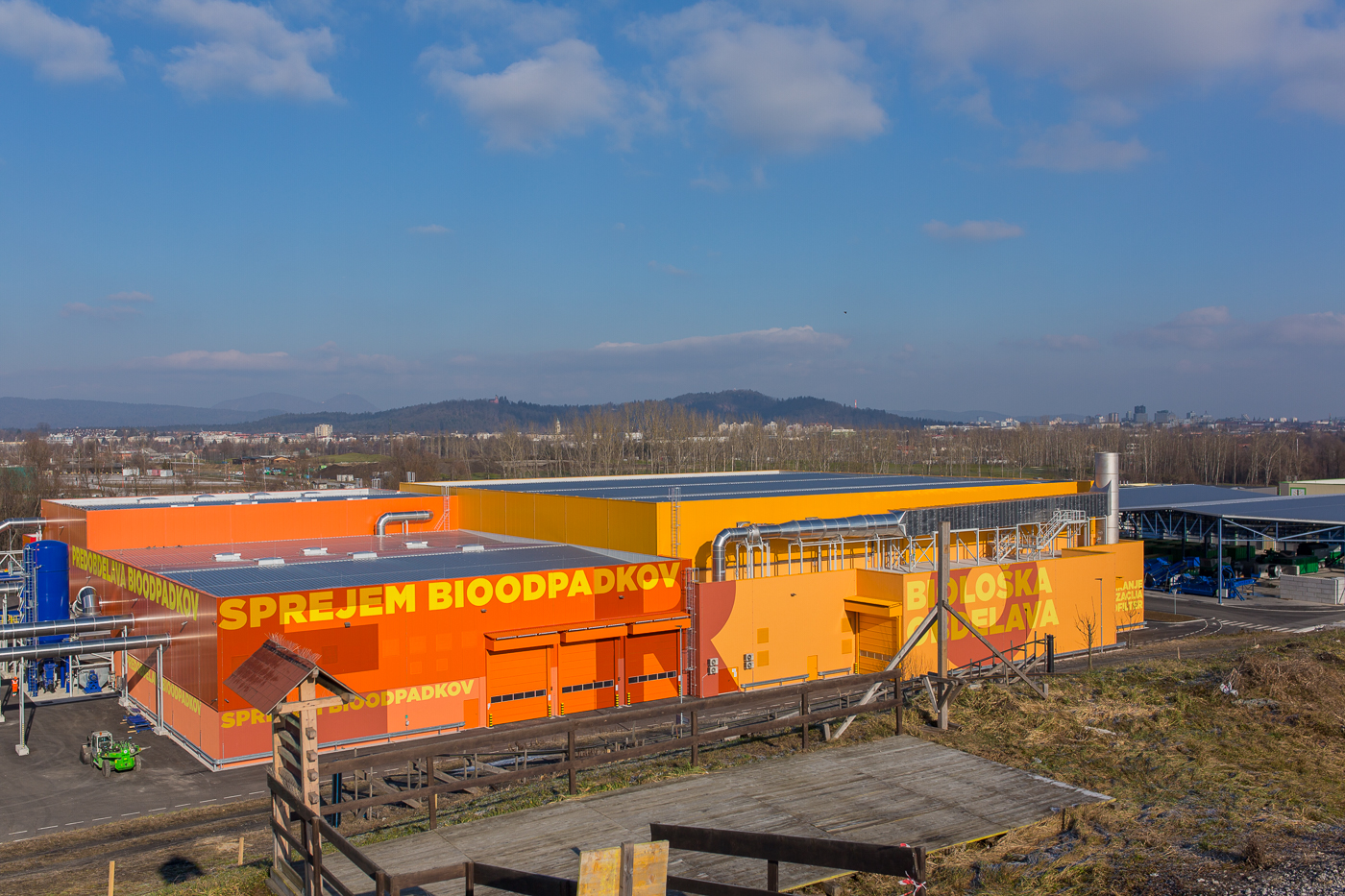
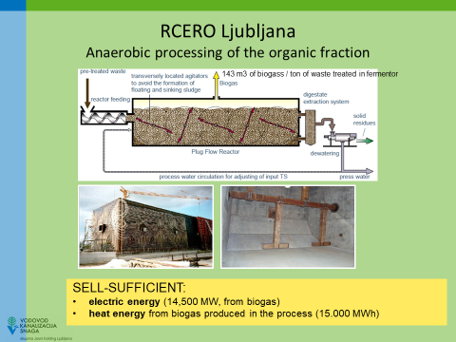
2,600 tons of compost following the treatment of separately collected organic biodegradable waste;
11,200 tons of sorted secondary raw materials,
64,000 tons of solid fuel from waste of different calorific values;
17,000 tons of digestate;
10,855 000 kWh of electric energy and
11,901 kWh of heat energy from biogas produced in the process.
Notes:
• 64.000 tons of solid fuel from waste of different calorific values;
• 17.000 tons of digestate;
• 10,855 000 kWh of electric energy and
• 11,901 kWh of heat energy from biogas produced in the process.

Slide 21
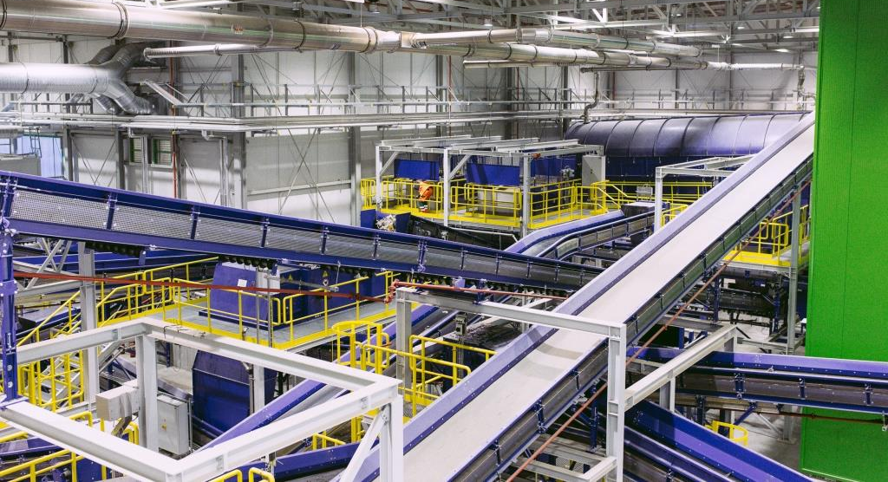
Residual waste is treated mechanically to extract usable materials for either recycling (9%) or production of solid fuel (77 %).
After treatment, around 14 percent of mixed waste received ends up at the landfill.

Slide 22

Organizing waste management activities in the company.

Slide 23
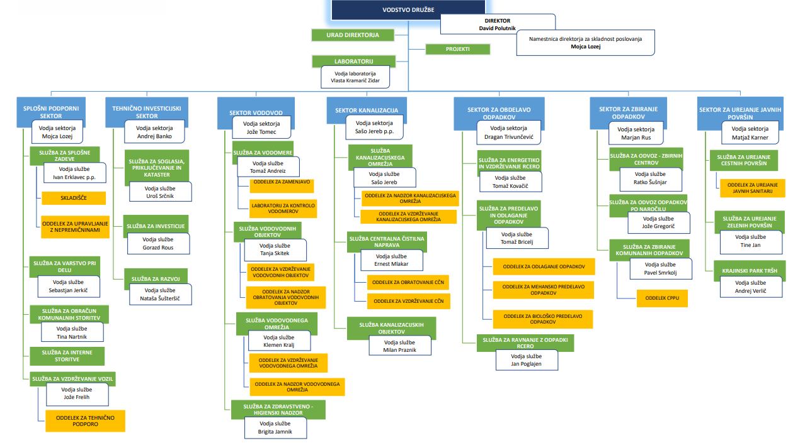
Organizational chart of VOKA SNAGA
Waste collection sector
Municipal waste collection service
On-demand waste collection service
Collection centers service
Waste treatment sector
RCERO energy and maintenance service
waste processing and disposal service
RCERO waste management service

Slide 24
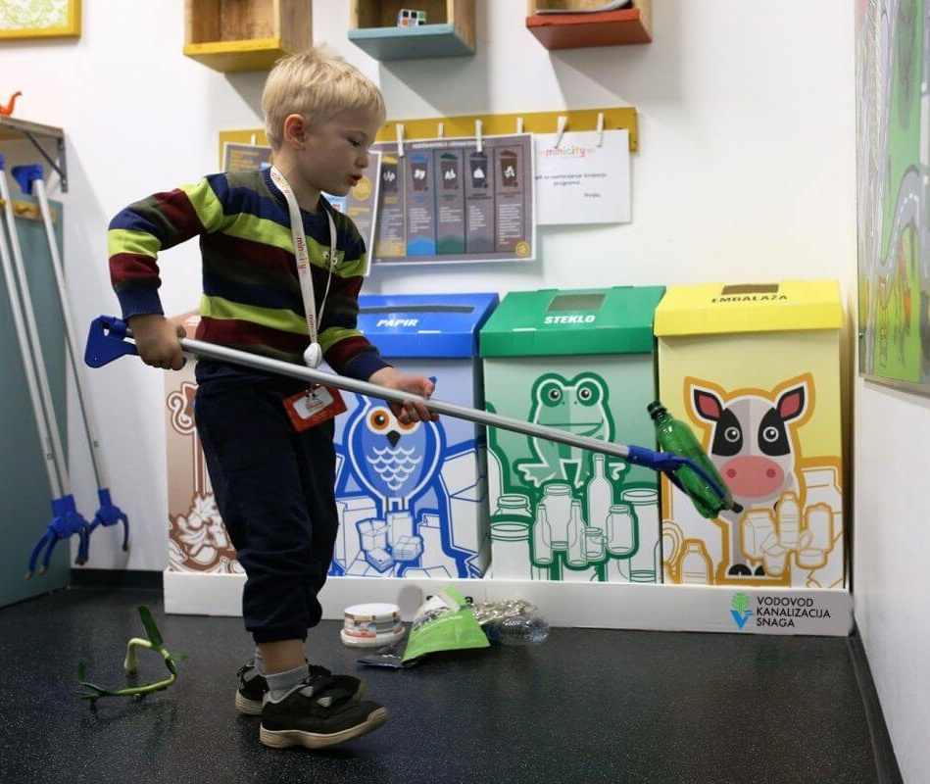
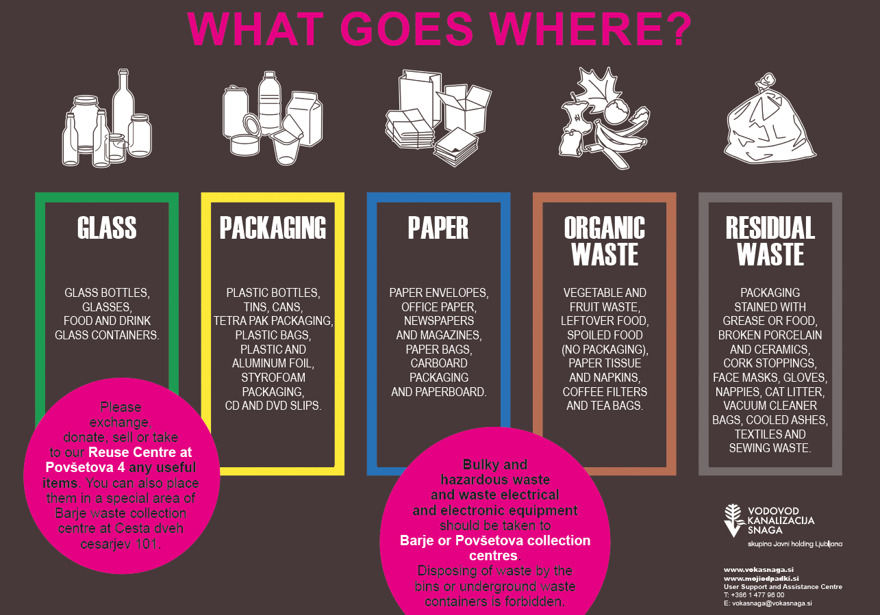
In 2019 Snaga has evolved into a multi-utility company.
  general support services (legal, financial, communication, IT, billing, etc.) are more stable,
  it was necessary to reorganize or adapt all processes in the company,
  decisions are made more slowly (it takes more time for the needs to be transferred from the operational level to the decision-maker level),
  the development of activities is embedded in the development of the entire company. As a result, decisions and further activities are made more slowly,
  once the plan is adopted, it does not change,
  there was no significant operational cost reduction,
  no lower user satisfaction was detected within the regular measurement of user satisfaction,
  currently, it is not possible to provide sufficient development funds within the company to enable the necessary activities, especially in the areas of prevention, reuse and other activities that are necessary for the development of public services. We are primarily focused on performing basic activities.

Slide 25
Waste collection development projects

Slide 26
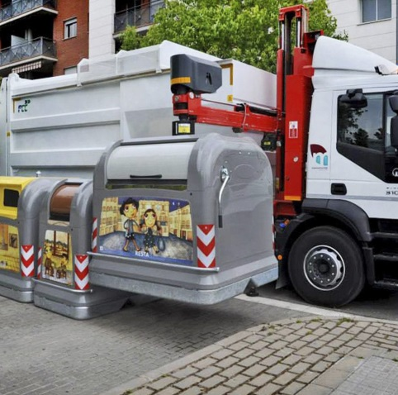
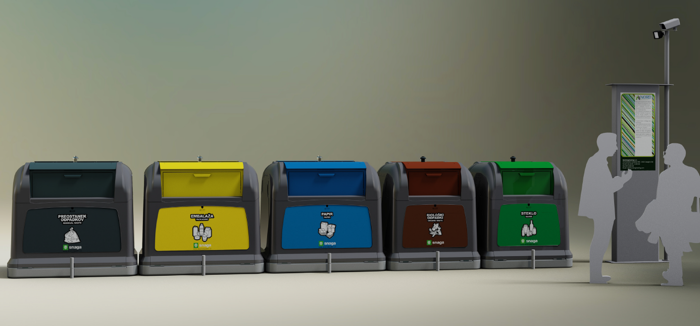
Above and underground container - multi apartment building
Planned upgrade of separate collection of municipal waste
Notes:
ena enota (MKO, bio, embalaža, papir steklena emb.) za cca. 350 prebivalcev
sistem evidentiranja in spremljanje polnosti,
zabojniki omogočajo sistem identifikacije in namestitev merilcev polnosti, ki omogočajo podajanje informacij o polnosti zabojnika, javljalnik ognja, nagiba zabojnika v primeru vandalizma,… primerno za implementacijo optimizacije planirane poti glede na polnost zabojnika.

Slide 27
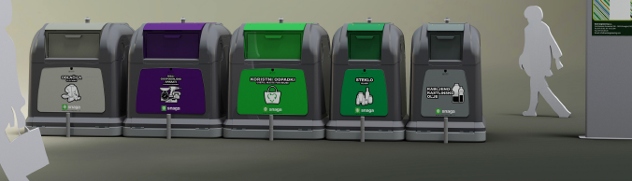
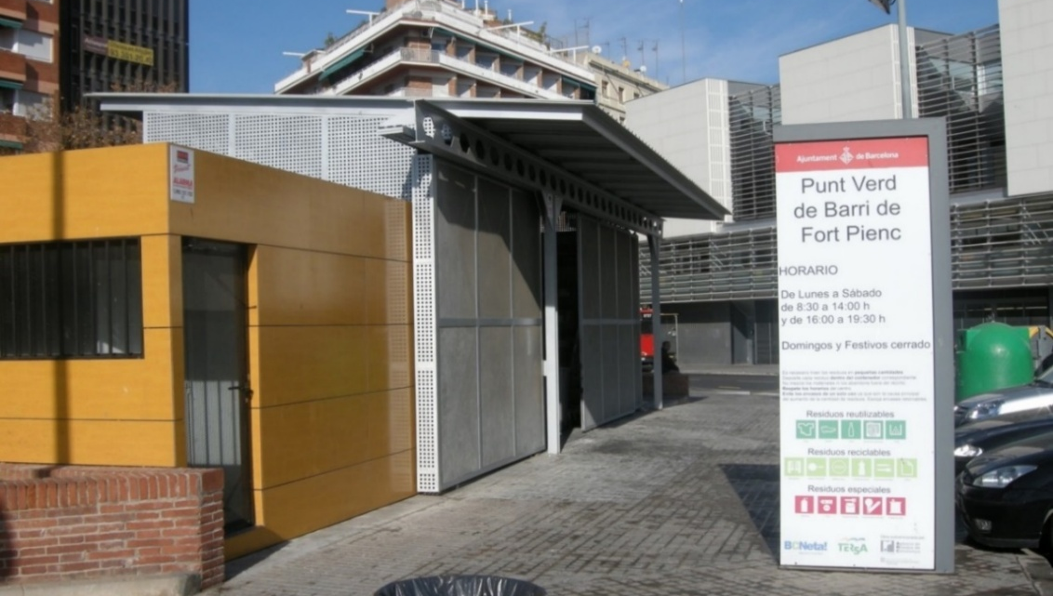
Planned upgrade of separate collection of municipal waste
Small collection centres
Expanded collection points
Small WEEE equipment
cooking oil
Clothes and textile
Glass packaging
Re-use materials (test)
Pictures: Barcelona 2015
Notes:
Predvideno zbiranje: Mala OEEO, oblačila in obutev, jedilno olje, steklene embalaža, koristni odpadki,…
sistemsko obvladovanja čistosti okoli razširjenih zbiralnic, velikost odprtine je primerna in prilagodljiva,
komuniciranje iz enega mesta za celoten sistem zbiranja oziroma ravnanja s komunalnimi odpadki,
praznjenje z enakim vozilom kar pomeni optimizacijo stroškov,
sistem evidentiranja in spremljanje polnosti,
Predlagamo jih za večja blokovska naselja, torej v območjih visoke gostote poselitve.
Namenjeni so okoliškim prebivalcem, da lahko redno predajajo ločeno zbrane odpadke (oblačila in obuvala, manjše OEEO, jedilno olje, zdravila, baterije, kozmetiko, čistila, barve in lake in skupine za ponovno uporabo kozarci in krožniki, knjige, igrače…), ki jih ne morejo razvrstiti v zabojnike pred vrati in jih ni potrebno z avtomobilom odpeljati na velike zbirne centre.
Omogoča neposredno komuniciranje z uporabniki naših uslug, predvsem z vsebinami preprečevanja nastajanja odpadkov in ponovne uporabe.

Slide 28
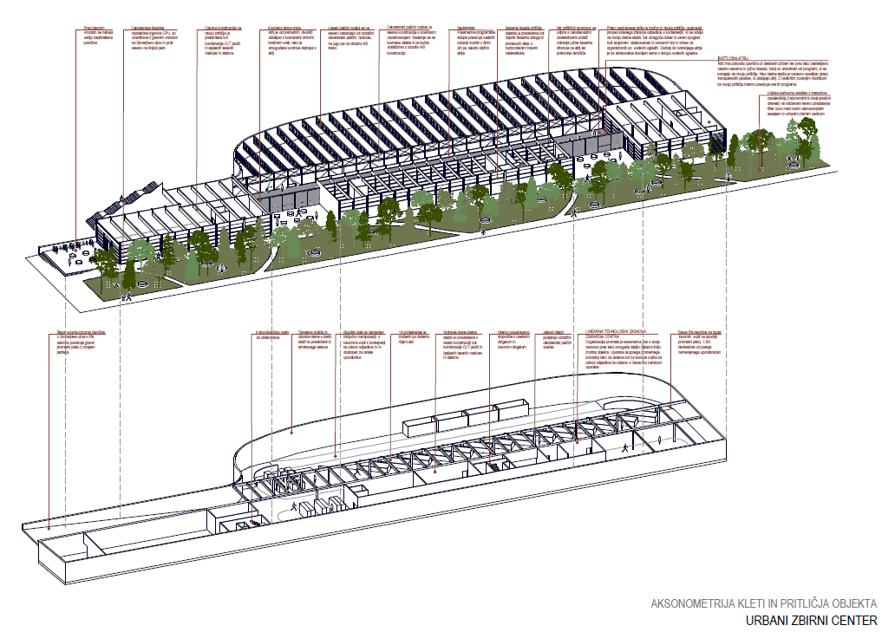
Urban collection centre
Collection cent for the collection of separated fractions of municipal waste,
Reuse center
Master workshop for handmade paper making

Slide 29

What have we learned?
Communicate, not educate.
Tell stories. Inspire change.
Cooperate and involve.
Deconstruct myths.
Establish good relations with media.
Think out of the box.
Be persistent.
Waste collection at source ensures cleaner collected fractions.
Quality service at a reasonable price is key to engaging users in the process.
Waste collection concepts need to be constantly upgraded and adapted.
Users need to understand more deeply, why they separate waste.
Notes:
Users must always have enough space in the containers for waste disposal.
containers must be clean

Slide 30
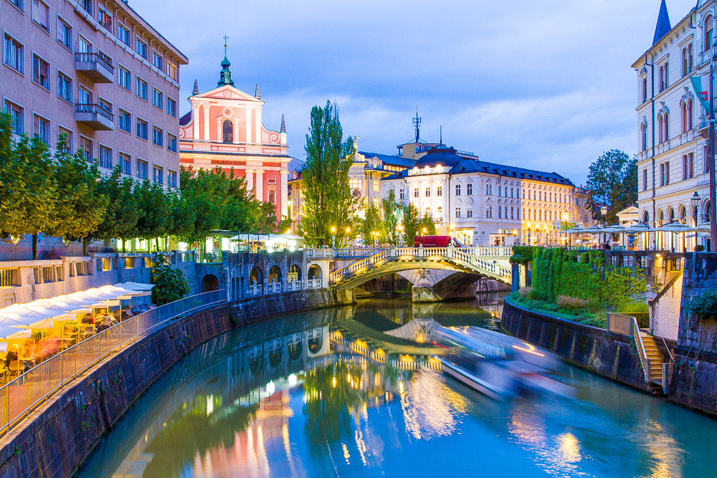
Video Manifest Get used to reuse (in English):
https://www.youtube.com/watch?v=NQTTI43w5Y4
Get used to reuse initiative (in English):
https://www.youtube.com/watch?v=IEtcocjJeoU
Raise your voice against food waste: https://www.youtube.com/watch?v=V2p2AwcBTnQ
Responsible consumerism:
https://www.youtube.com/watch?v=U63SdCZClOw
https://www.youtube.com/watch?v=n8WaPy8VbaI
RCERO LJUBLJANA and circular economy: https://www.youtube.com/watch?v=ODiMYudI2Cg
APPLAUSE – from harmful to useful with citizens' led activities
https://www.youtube.com/watch?v=eZjqjLwt_r0&list=PLeJixfrhaf42_WUfyB4z4L-oeBteSTgOP&index=16

