Slide 1

Key considerations for the procurement of flexible services and the promotion of shared responsibility on the part of the contractor
Phd. Pásztai Zoltán-Attila
Waste Management Specialist
General Manager ECO Bihor and AVE Romania

Slide 2

Phd. Pásztai Zoltán-Attila
GM ECO Bihor and AVE Romania
zoltan.pasztai@gmail.com
1. About us - Closing the loop
Short self-introduction: more than 20 years of expertise in collection, sorting, landfilling, composting, MBT, plastic recycling and biogas.
Our group of companies are based on anmost economy model where products are reused or recycled rather than discarded, following up with customers after they provide feedback, ensuring complete communication in a team setting, or concluding a business discussion by resolving actions and decisions.
Our company group includes all the waste management activities to achieve circular economy standards:
  DOOR TO DOOR collection of municipal WASTE (6 different streams)
  transfer and sorting plants
  MBT plants
  landfill
  biogas station
  compost stations
  LDPE,PP,HDPE plastic recycle factory

Slide 3
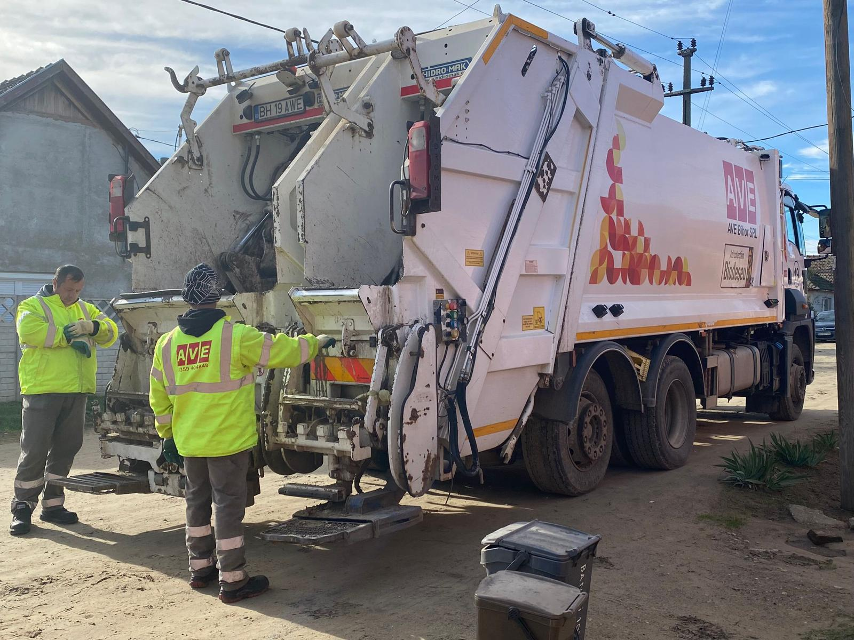
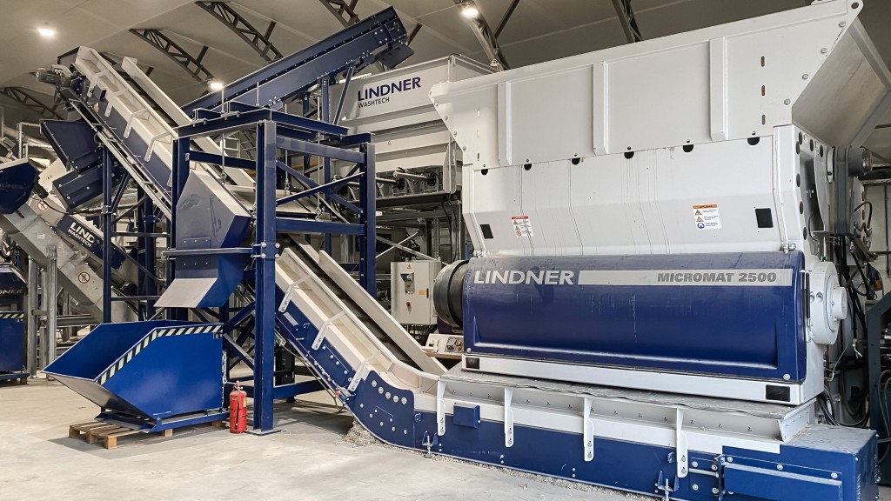
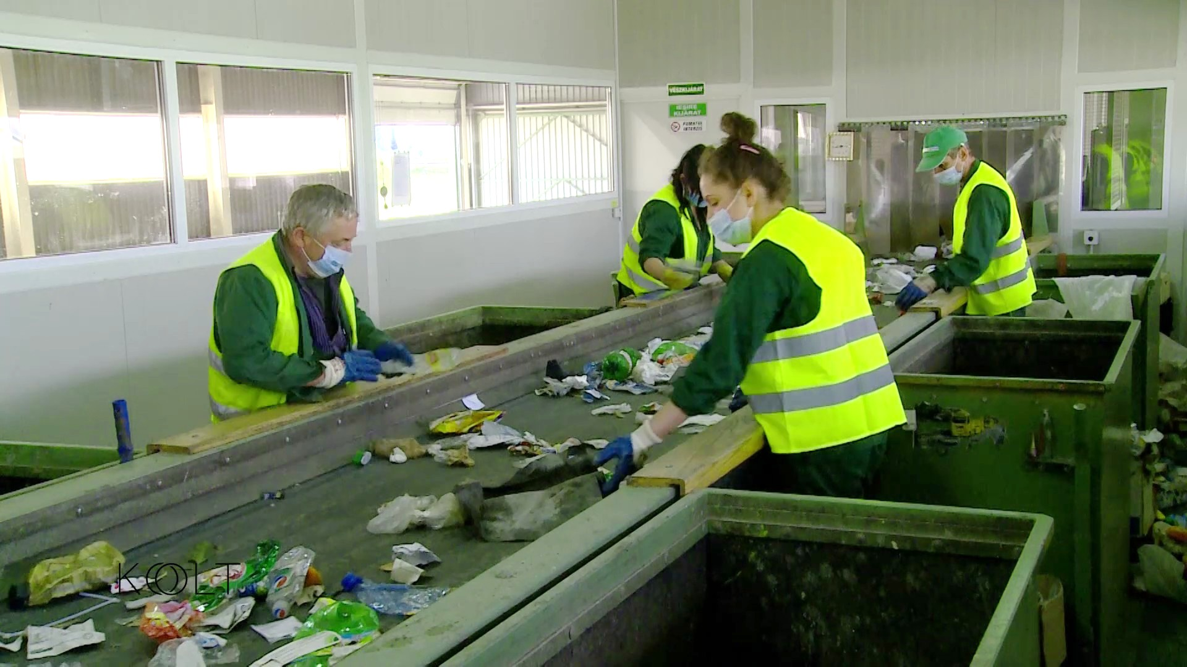
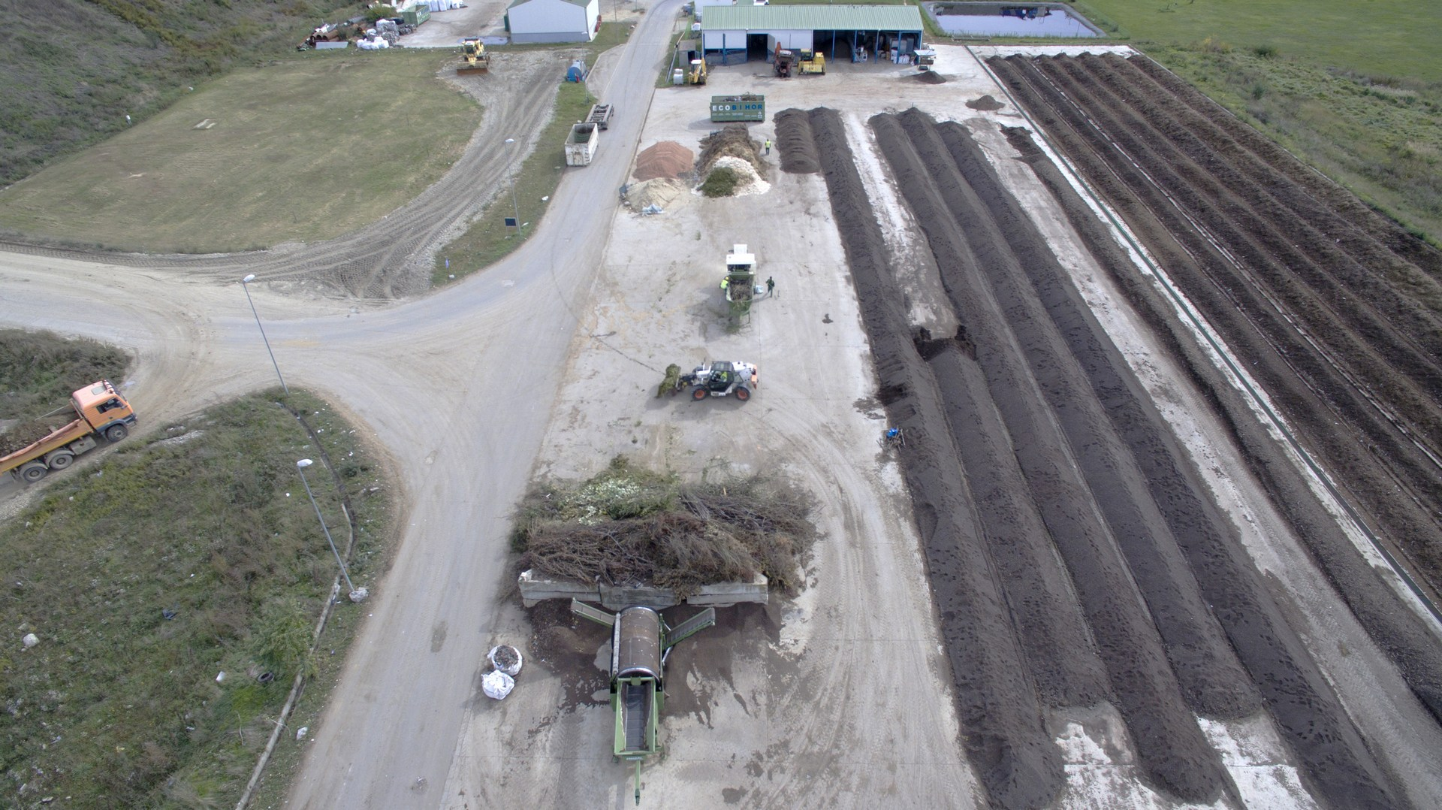
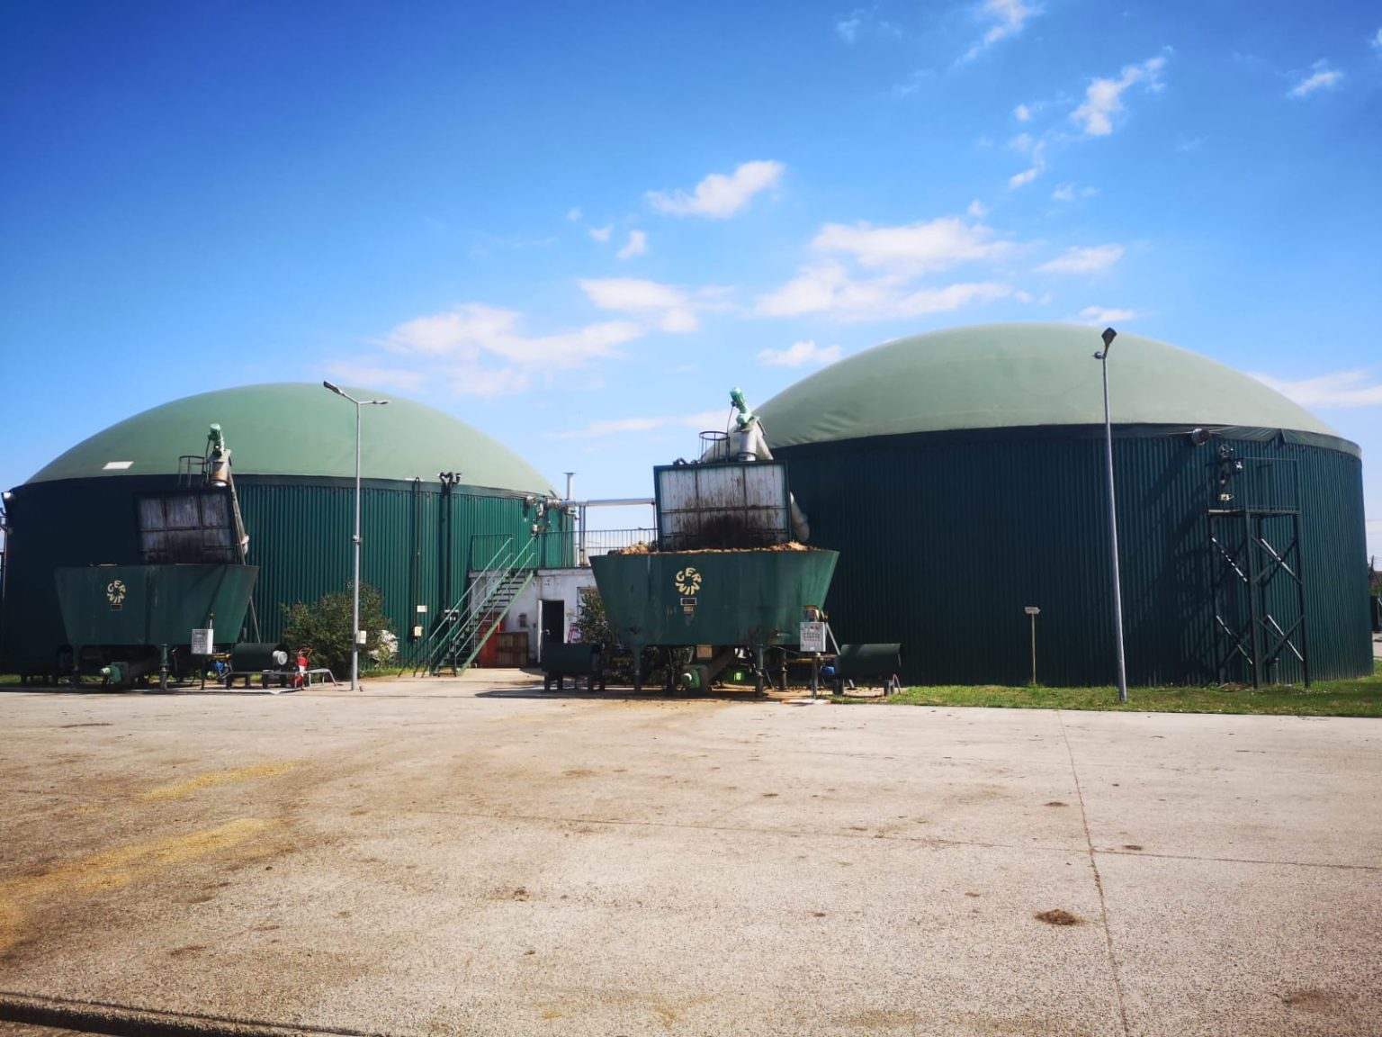
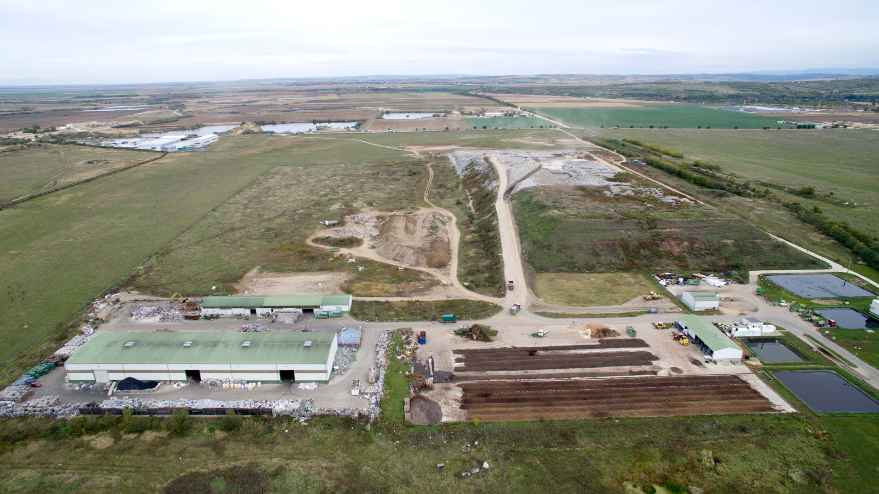
Phd. Pásztai Zoltán-Attila
GM ECO Bihor and AVE Romania
zoltan.pasztai@gmail.com

Slide 4
Phd. Pásztai Zoltán-Attila
GM ECO Bihor and AVE Romania
zoltan.pasztai@gmail.com
Several kinds of partnership with the authorities -
in our portfolio:
PPP contract - DBO project for 20 years
direct delegation - for smaller size of projects
public procurement - the most used way to contract public services - a method full of difficulties that also takes too much time

Slide 5
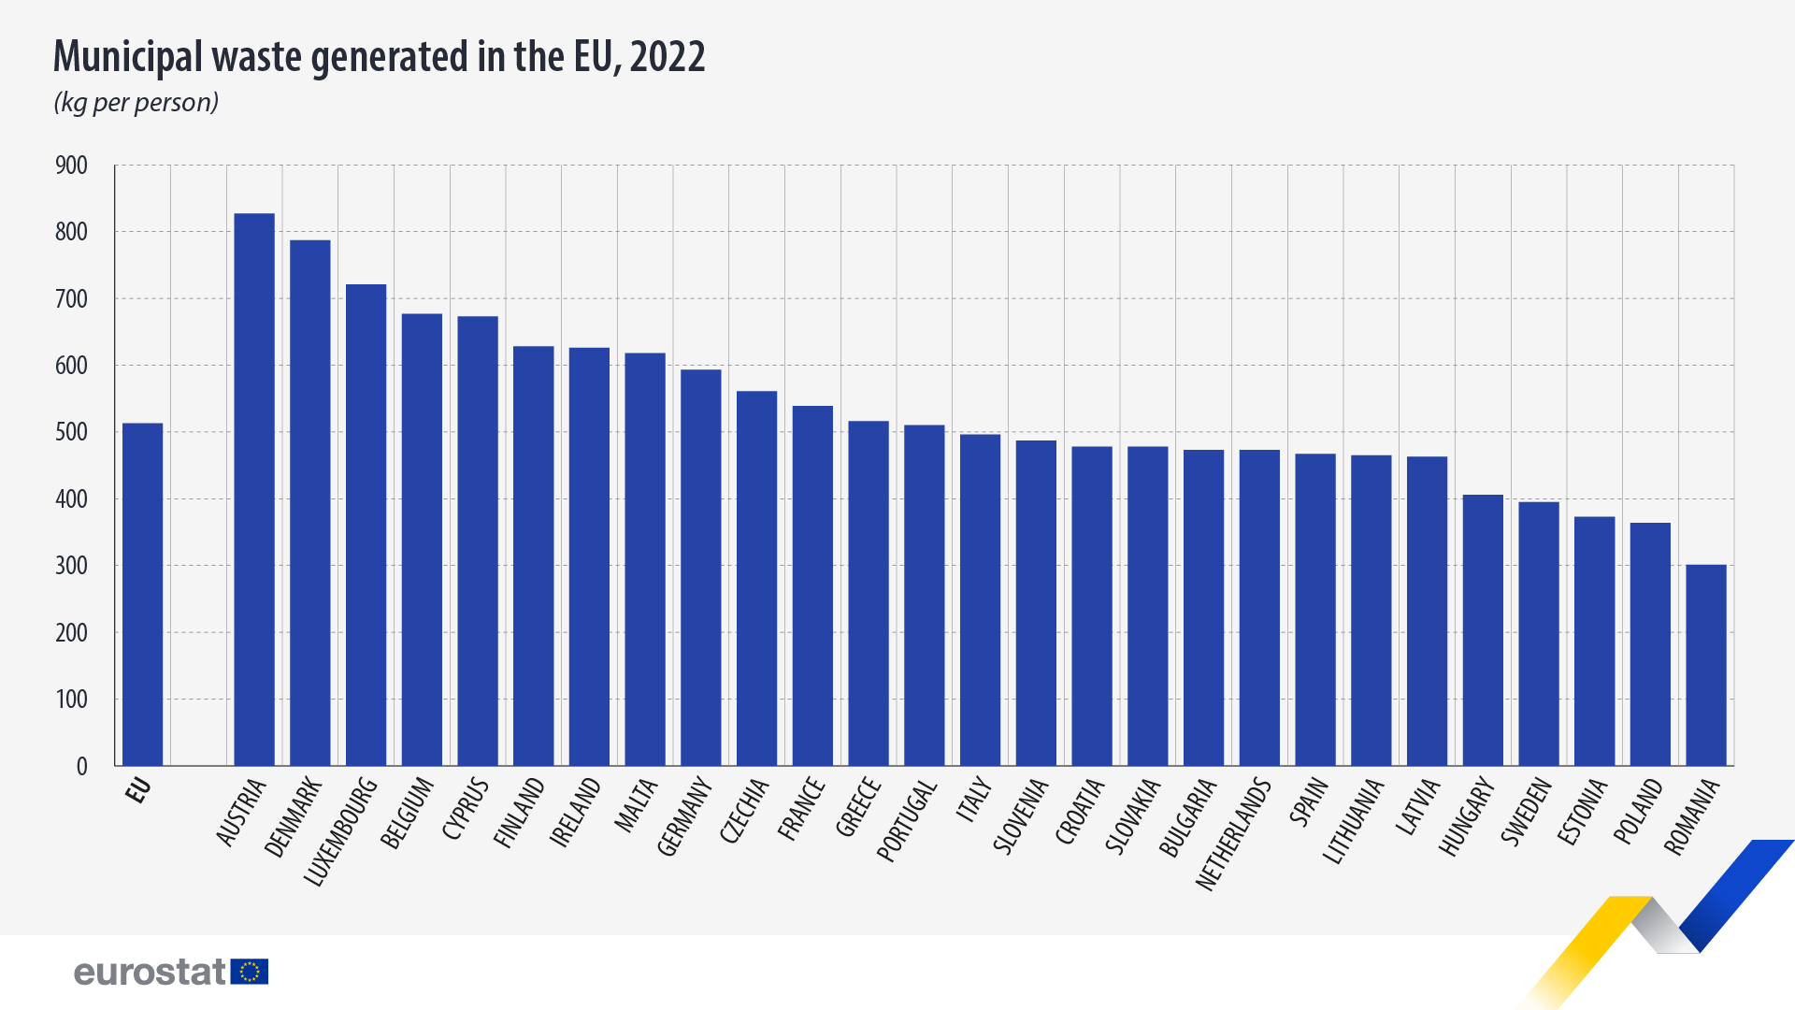
Phd. Pásztai Zoltán-Attila
GM ECO Bihor and AVE Romania
zoltan.pasztai@gmail.com
2. Current situation of municipal waste management in Romania:
  Cooperation between municipalities and private operators.
  Main challenges: low separate collection rate, landfill dependency, financial difficulties on the side of both the population and municipalities.
  Lack of professional expertise within local governments, which makes cooperation with private service providers difficult.
BUT - as a Best Practices (as exceptions)
The communes of Sălacea (3000 inh.) and Cociuba Mare (2700 inh.) record 75% on separate collection, among the highest in Romania.

Slide 6
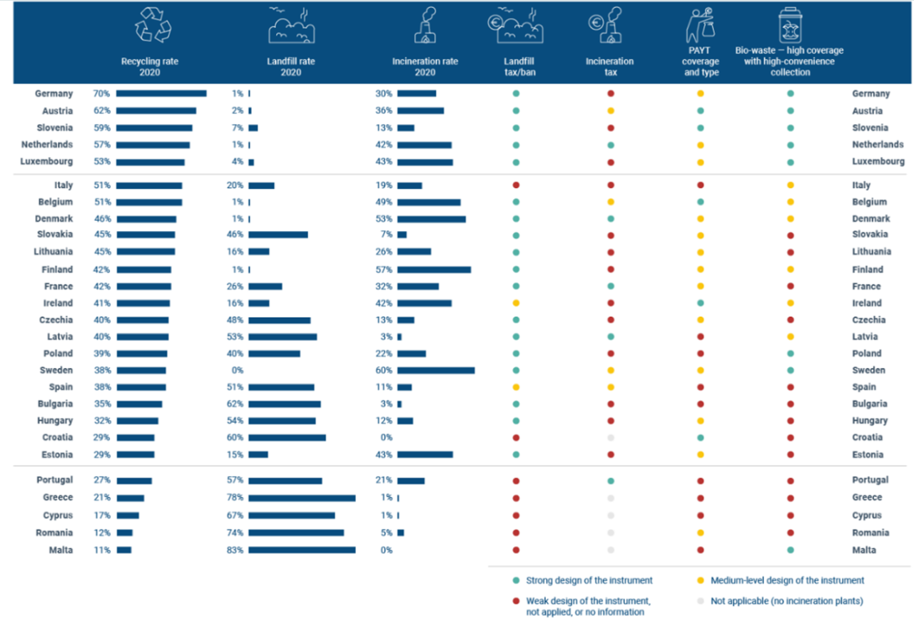
Phd. Pásztai Zoltán-Attila
GM ECO Bihor and AVE Romania
zoltan.pasztai@gmail.com

Slide 7
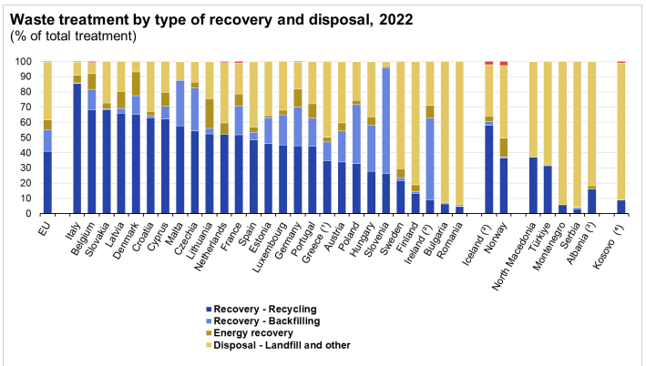
Phd. Pásztai Zoltán-Attila
GM ECO Bihor and AVE Romania
zoltan.pasztai@gmail.com
3. The situation of waste management in Romania before the introduction of the RetuRO (DRS) system (2023)
In Romania there are recycling facilities for different types of materials.
However, the separate waste collection rate is still very low - only 12.3% in 2022 - according to Eurostat.
With this share, Romania ranked at the end of the line in the EU on municipal waste recycling.

Slide 8
Phd. Pásztai Zoltán-Attila
GM ECO Bihor and AVE Romania
zoltan.pasztai@gmail.com
4. Shared responsibility between stakeholders
Municipalities:
  There exists many bottlenecks and barriers that prevent packaging waste management from reaching its full potential. Acutely worrisome is the adoption of inadequate collection and implementation strategies especially among regions and municipalities with less experience. The measures that have limited ability to reach high service coverage, participation levels, and quality of the output will not fully satisfy the Romanian objectives.
  regulation – not in practice, monitoring – missing completely,
  Multitude of barriers plague the Romanian institutions and stakeholders struggling to meet the RO targets for separate collection of recycling waste and the landfill targets, thereby precluding the closure of the packaging-waste cycle. Many barriers are interrelated and dispersed across Romanian municipalities, necessitating multiple transversal and vertical solutions to overcome them.
Contractors: can be either municipally owned or private companies; role in efficient operations, innovation, cost optimization - knowhow deficiency.
Citizens:
  participation in separate collection – a lot to work on,
  return of deposit containers – seems to work now,
  responsible behavior – a lot to work on.
Good practices: joint monitoring systems - thru door to door collection, transparency, financial incentive schemes.

Slide 9
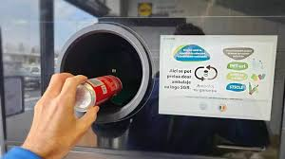
Phd. Pásztai Zoltán-Attila
GM ECO Bihor and AVE Romania
zoltan.pasztai@gmail.com
5. Impact of the “RetuRO” Deposit-Return System
Overview: introduction of a nationwide deposit-return system for PET,
aluminum, and glass beverage containers.
Positive impacts:
Significant increase in collection rates → alignment with EU recycling targets.
In July 2025, more than 580 million DRS packaging units were collected – a monthly record since the system was launched in November 2023 – representing 79% of the packaging placed on the market (in 2024 the percent was only 55%). The highest collection rate is for glass packaging, at 82%. This performance surpassed expectations, and the system, after learning from the first year of operation, is moving towards new objectives for 2025, maintaining the guarantee value of 50 bani (0,5 lei = 0,1 euro).
New infrastructure: reverse vending machines, dedicated logistics chains, specialized processing facilities.
Improved quality and cleanliness of recyclable materials in the RetuRO system - no liquid or any content allowed.

Slide 10
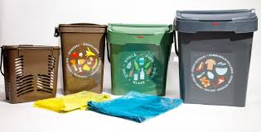
Phd. Pásztai Zoltán-Attila
GM ECO Bihor and AVE Romania
zoltan.pasztai@gmail.com
6. Challenges for private waste operators:
Substantial revenue loss for municipal sanitation operators: about 90% of PET bottles have been removed from the municipal collection stream (comparing June 2023 - June 2025).
Lack of central government coordination measures for aligning the system.
Packaging waste targets (both in quantity and percentage) remained unchanged, making them in practice impossible to achieve → unrealistic performance indicators without PET.
Collection system redesign:
  Reduced volumes required route, vehicle and
bin size optimization (20, 30, 40 liters)
and less frequent collection schedules.
  Surplus fleet and redundant trained workforce appeared.
  Additional logistical and organizational costs + two-compartment waste collection vehicles.
  Introduction of RFID systems in all public tenders, for an exact control of collection.

Slide 11
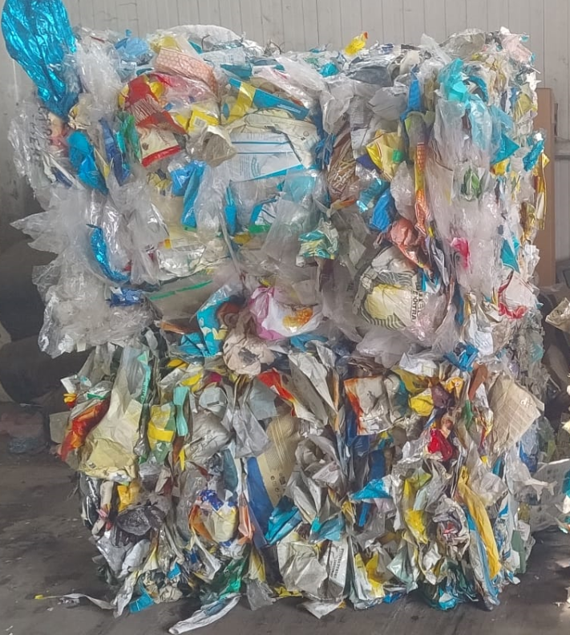
Phd. Pásztai Zoltán-Attila
GM ECO Bihor and AVE Romania
zoltan.pasztai@gmail.com
Impact on sorting facilities:
  The composition of incoming materials changed significantly.
    drinking bottles almost 0%, flexible packaging, biowaste
    the sorting plant technologies not adequate for sorting flexible packaging
    the sorted materials are much lower quality,
    not adequate for the existing recycling technologies - household waste is often too dirty, would be good from industry
  PET – previously one of the most valuable material – is no longer available, leading to a decrease in the quantity and value of recoverable recyclables.
  According to our database, the current composition of separately collected recyclable waste streams has significantly shifted - PET / Total income 13% in 2022, under 2% in 2025.
    content of collected recyclables PP, PS, LDPE,HDPE
  Severe financial consequences for operations and long-term investment sustainability - 2024 was a huge financial - minus for the waste operators in Romania

Slide 12
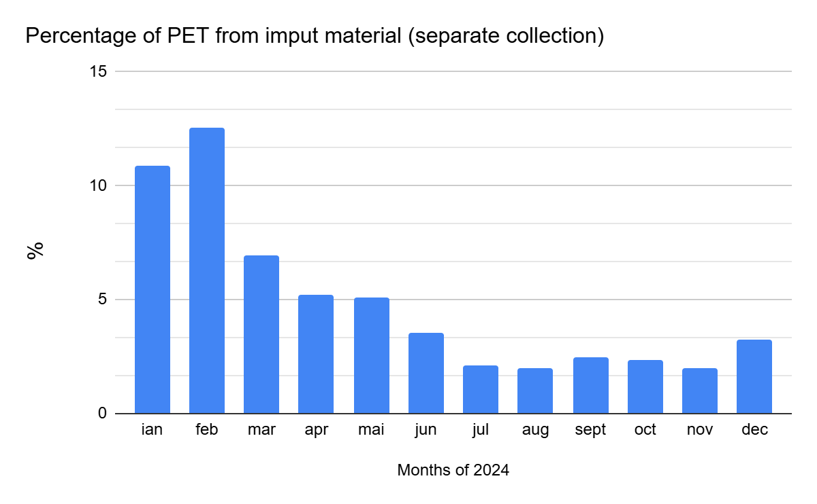
Phd. Pásztai Zoltán-Attila
GM ECO Bihor and AVE Romania
zoltan.pasztai@gmail.com
📍🗺️ Eco Bihor Separate Waste Sorting Station,
Covasna county, Romania

Slide 13
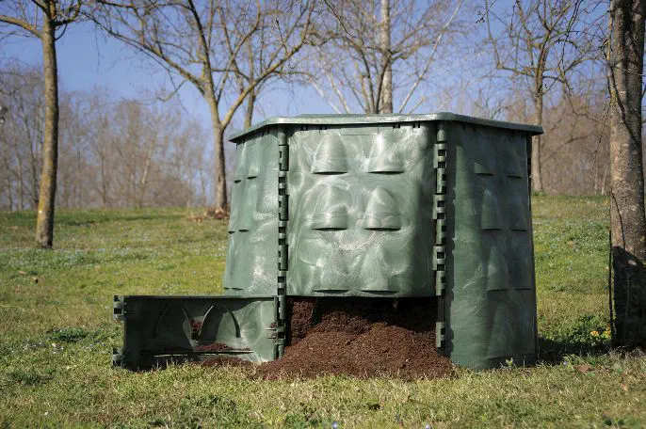
Phd. Pásztai Zoltán-Attila
GM ECO Bihor and AVE Romania
zoltan.pasztai@gmail.com
7. Strategic recommendations for the future
Integrated approach: aligning public service contracts
with new requirement driven waste management systems.
Innovation: digitalization, data-driven decision-making.
Education and awareness-raising: increasing citizen participation
Must raise accountability on both individual and collective level.
Regional cooperation: joint investments, shared sorting facilities - appropriate control of quality on recyclables
Strengthening the circular economy approach - increasing biowaste separate quantities
Exert pressure on politicians to set and enforce realistic targets, which considers the whole system, not just parts of it.

Slide 14
Phd. Pásztai Zoltán-Attila
GM ECO Bihor and AVE Romania
zoltan.pasztai@gmail.com
Conclusion
Summary:
Flexible services are essential to adapt to a changing environment.
Shared responsibility is the foundation of long-term sustainability.
The RetuRO system represents both opportunities and challenges.
Demand for new business models: adaptation to the RetuRO system, diversification of services, focus on other waste streams (ex. recyclable flexible packaging and biowaste).
It is essential to level up by raising responsibility, putting in practice accountability and penalties also for the users of the services, not just the contractors - political accountability is crucial in this.
Conclusion: RetuRO system is a success story both in Romania and the EU. It is welcomed, even though it came a bit late, BUT the private service providers were not prepared for it’s introduction.
Final message:
Success depends on cooperation and innovative, flexible contractual solutions, by all three sides – contractors, municipalities and authorities (political will).

Slide 15
Phd. Pásztai Zoltán-Attila
GM ECO Bihor and AVE Romania
zoltan.pasztai@gmail.com
THANK YOU FOR YOUR ATTENTION!

