Slide 1

Nudging as a Tool to Improve Selective Collection Outcomes
Percy Foster
Managing Director, Foster Environmental, Ireland

Slide 2
Background
Commercial Food Waste Collection Regulations since 2009
Household Food Waste Regulations since 2013- phased in and then all households in 2024
Number of apartments in Ireland: 240,000 in 2022
Government Policy is 25,000 apartments to be built per year
Primarily in main cities in Ireland

Slide 3
Domestic Apartment Collection System
Open waste collection market in Ireland done by private sector
Dedicated waste areas/sheds for apartment tenants
Weekly food waste collection service
Tenants pay flat yearly service charge (which includes waste, maintenance, security etc.). Therefore money/costs associated with recycling not a motivator.
Recycling Rate: Ireland’s Municipal Solid Waste (MSW) recycling rate stands at 41%, unchanged over the past decade

Slide 4
Background
In 2023, only 3,381 tonnes of food waste was collected from Irish apartments compared to 50,677 tonnes of residual waste.
Improving food waste recycling in apartments presents a key opportunity to raise Ireland’s overall recycling performance and to provide additional valuable feedstock for Ireland’s bioeconomy.
Contamination in household food waste bins is approximately 9% nationally; however, there is currently no available data for apartment buildings.

Slide 5
Objectives
Research Objective:
Investigate how simple, targeted behavioural “nudges” can boost food waste recycling in Irish apartment buildings:
  Conduct food waste collection trials in Irish apartments to determine which methods most effectively encourage apartment resident participation in food waste recycling, resulting in higher volumes of food waste collected with minimal contamination.
  Recommend the ideal collection model and an educational toolkit for use in existing and future apartments in Ireland following consultation with key stakeholders.

Slide 6
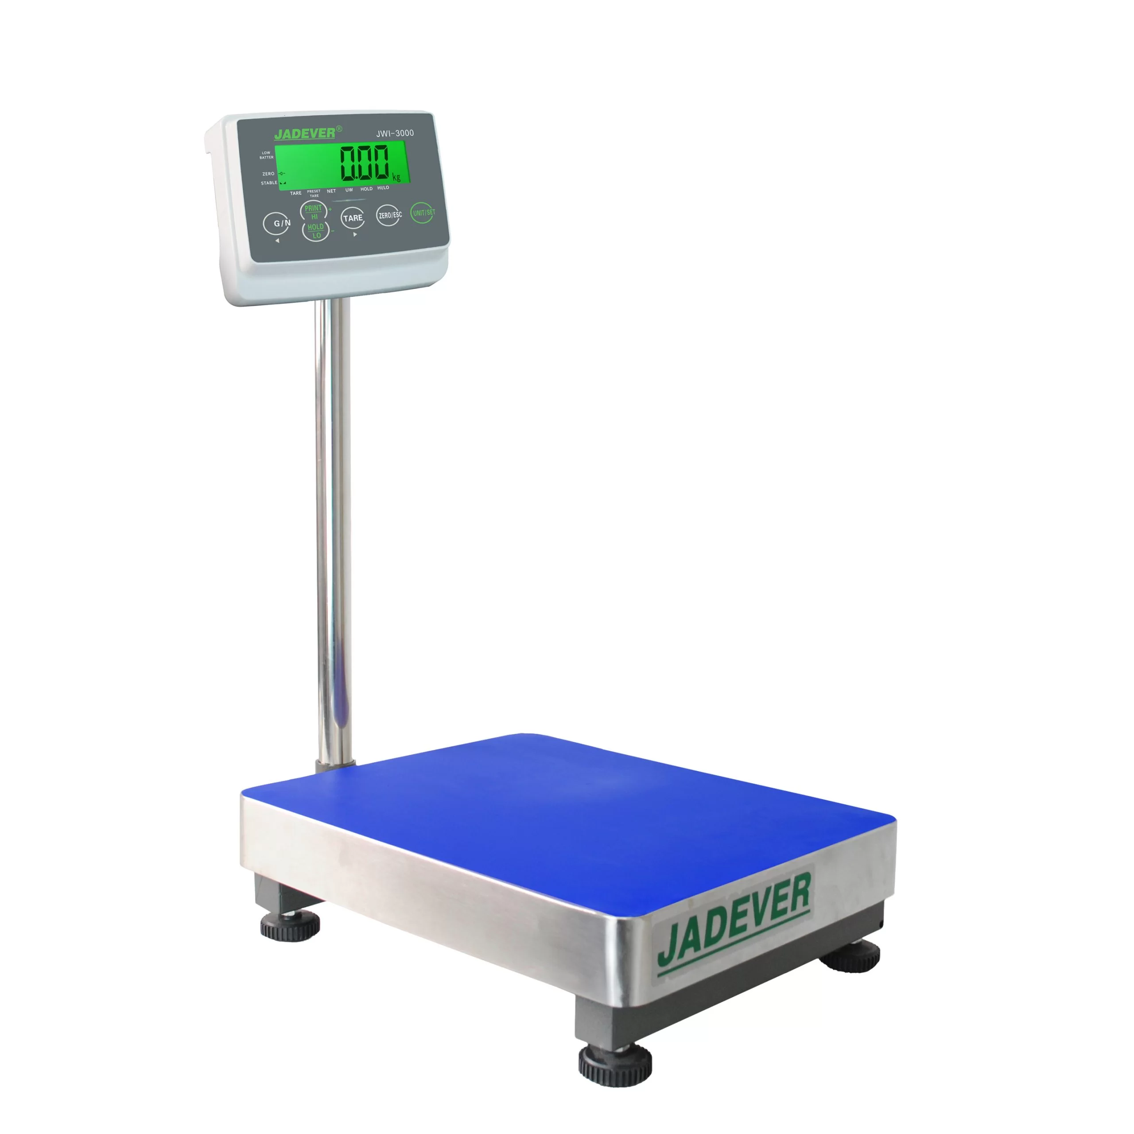
Research Overview
Trials conducted in apartment blocks with existing food waste collection.
14 Trials over 4 phases – Phase 4 was the Validation Phase.
  Each Trial was 6 weeks in duration, across approx. 30 apartments.
  Baseline data, put in place the intervention, measured weekly food waste collected over 6 weeks.
  Used baseline data for comparison to identify and trend behavioural changes.
  Included pre- and post-trial waste characterisations to identify level of contamination.
Exploratory, Iterative Research: As the trials progressed we refined our interventions based on what was most effective.
Food Waste Bins weighed before trial for baseline data and weekly to see the trend from each intervention.

Slide 7
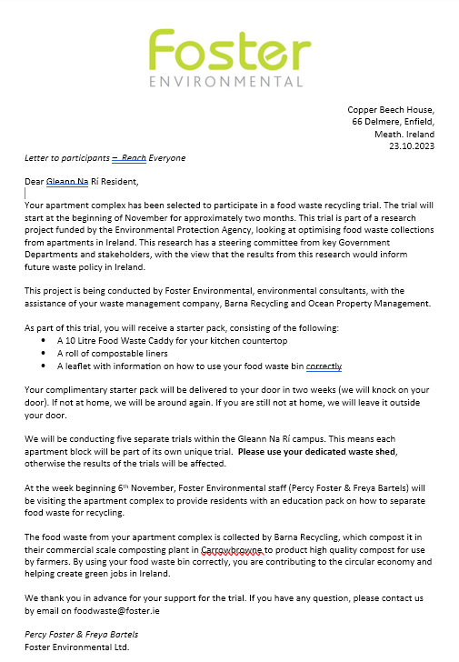
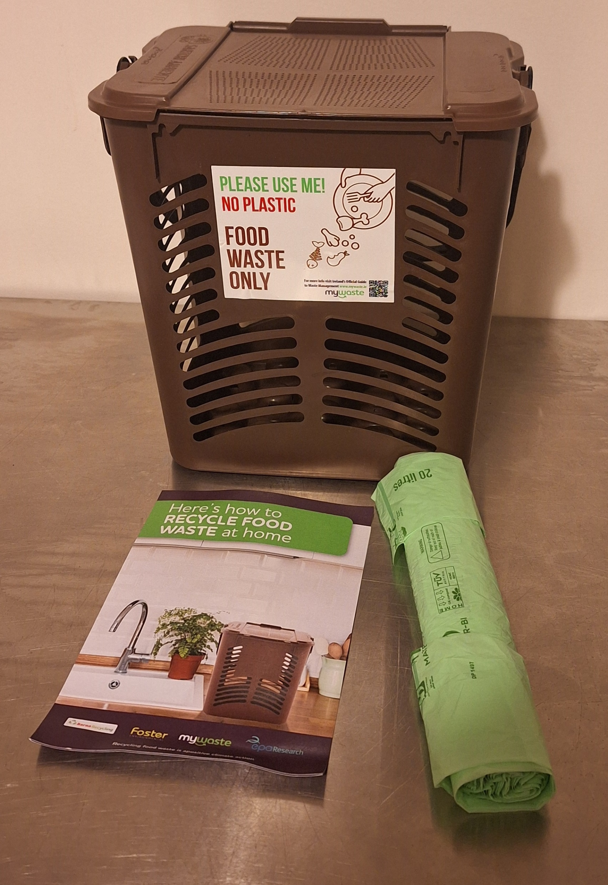
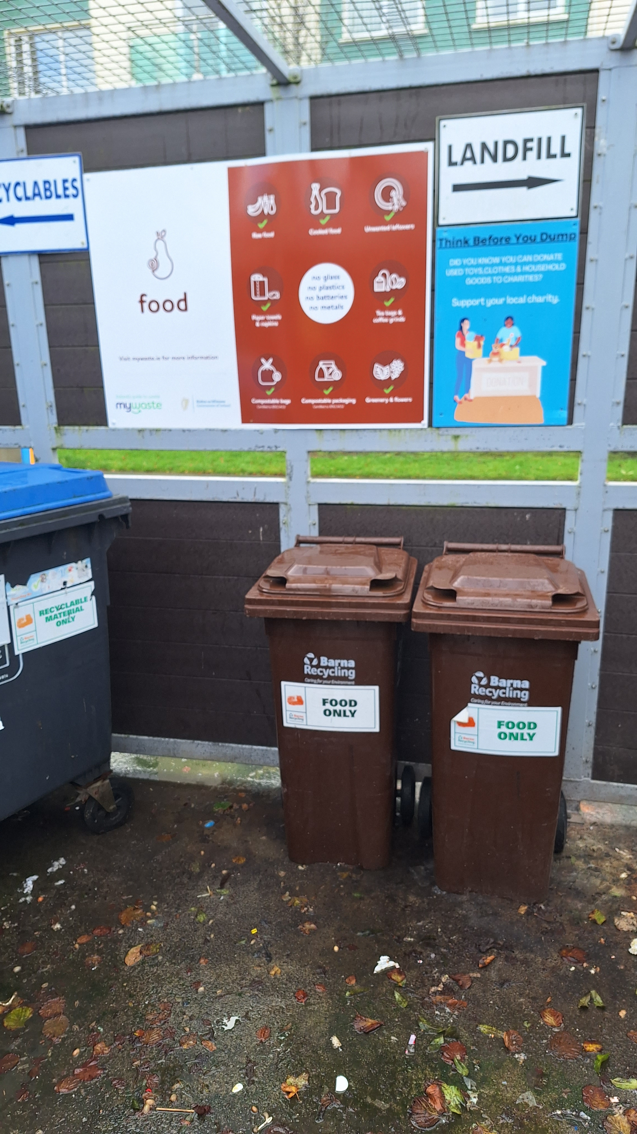
Tools - The Basic Package
For Each Trial, apartment residents were presented with the Basic Package:
Letter to inform that trial was taking place
Provided with kitchen caddy, supply of compostable bin liners and information leaflet
Signs put up in waste shed, clean food waste bins provided

Slide 8
Interventions Trialled
Leaflet only in post box: Not provided with the basic package i.e. the kitchen caddy and compostable bin liners.
Basic Package: Kitchen caddy, compostable bin liners & informational leaflet.
Reach (door to door): explain recycling and give the basic package i.e. the kitchen caddy and compostable liners.
Constant Tutoring: a trainer will be present at waste sheds for 3/4 occasions at the start of the trial
Motivational Messaging: regular nudging communications “others are doing much better than you”
Rewards: If you recycle 80% of food waste, you get a voucher for local school or club
Food Waste Bin at Entrance: Food waste bin placed near the apartment building entrance.
Reduced Residual Waste Bin: The residual waste capacity in the waste shed reduced
As Trials progressed, we also combined various nudging techniques to test their combined effect on food waste recycling rates.

Slide 9
Key Findings

Slide 10
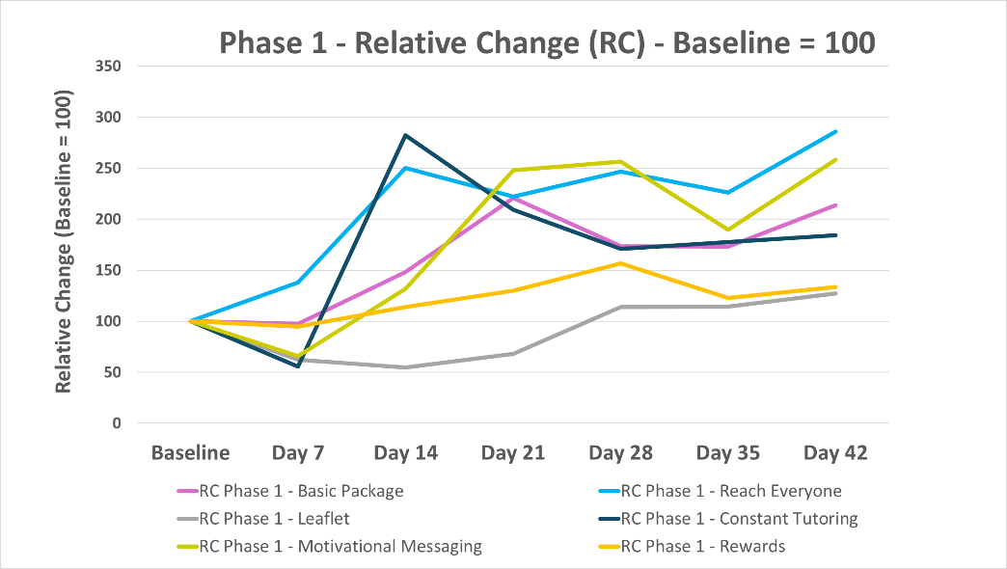
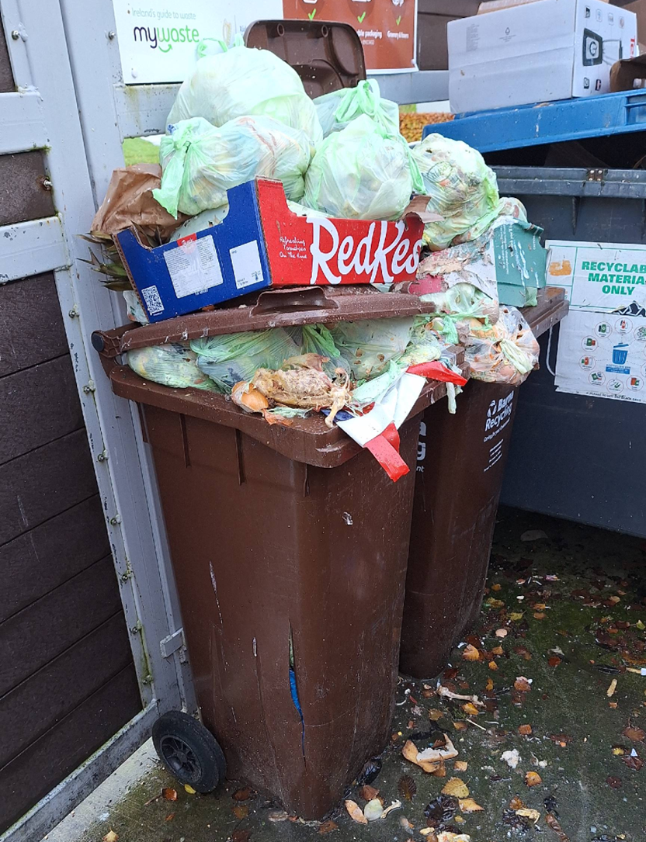
Phase 1 - Results
Key Takeaways:
Reach Everyone and Motivational Messaging showed a relatively strong initial increase in food waste recycling.
Constant Tutoring: Initially showed very strong results. However due to the sudden increase in food waste collected, bins overflowed. Lesson Learned: ensure enough bins provided. Repeated attempt at Constant Tutoring – no affect

Slide 11
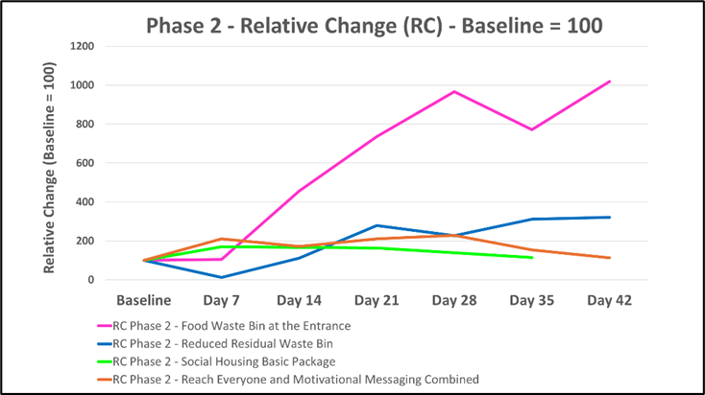
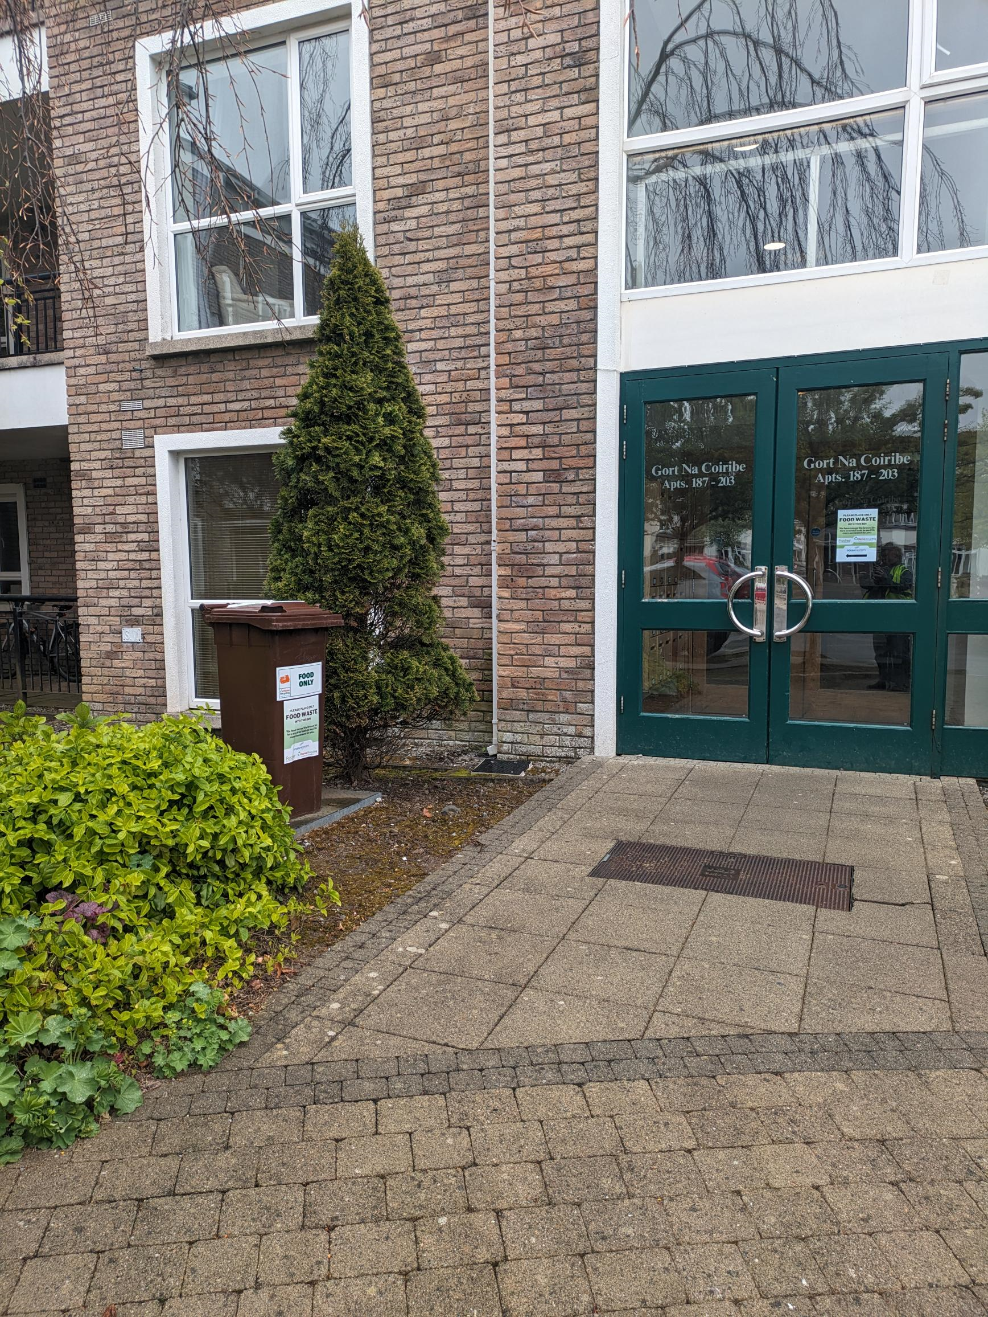
Phase 2 - Results
Key Takeaways:
Clear front runner: Food Waste Bin at the Entrance. However started from a very low baseline (0.18kg/apartment/week).
We extended Food Waste Bin at the Entrance Trial over the summer months- no odour or pest issues were raised.

Slide 12
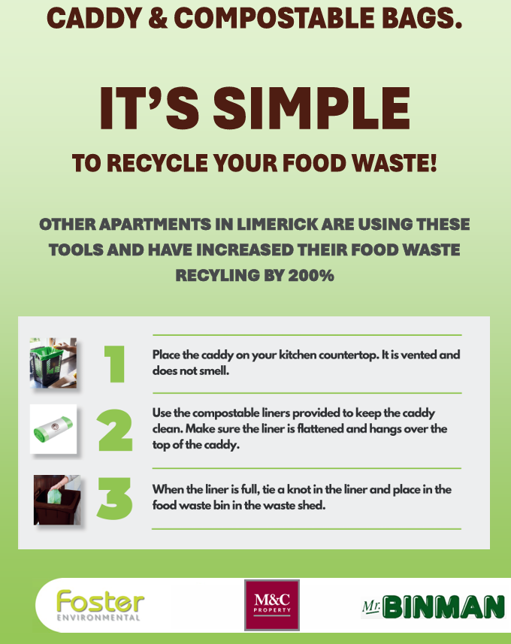

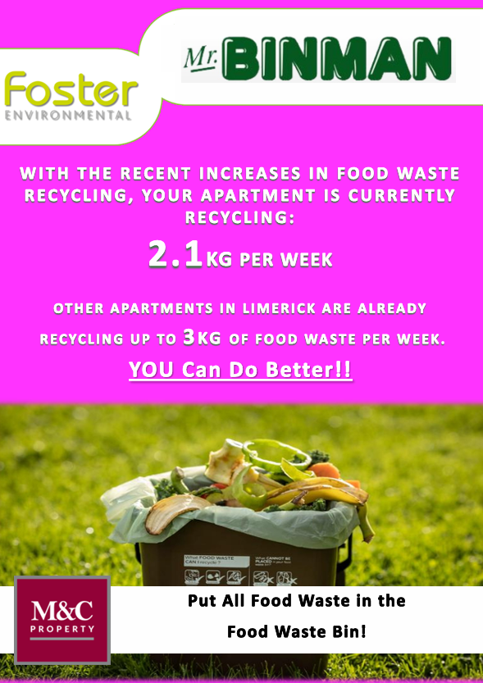
Motivational Messaging: Examples
Key Takeaways:
We thought we’d see better results from Motivational Messaging and Reach Everyone Combined in Phase 2. We strengthened the Motivational Messaging: Increased frequency: fortnightly to weekly Strengthened the language Changed the colour of the flyer each week

Slide 13
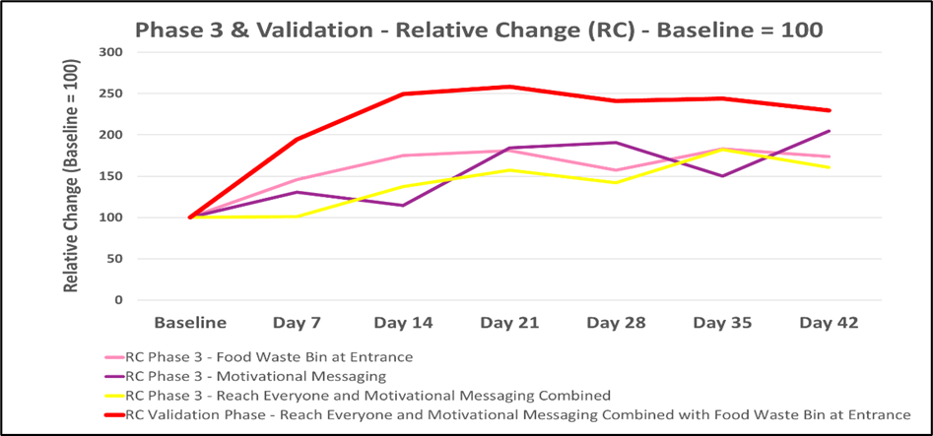
Phase 3 and Phase 4: Validation - Results
Key Takeaways:
Phase 3: Repeat of the best performers. Good Success
Validation Phase: Combination of Reach Everyone and Motivational Messaging Combined with Food Waste Bin at Entrance Strong Increase in Food Waste recycling Average increase in Food waste Recycling of 143% from Baseline

Slide 14
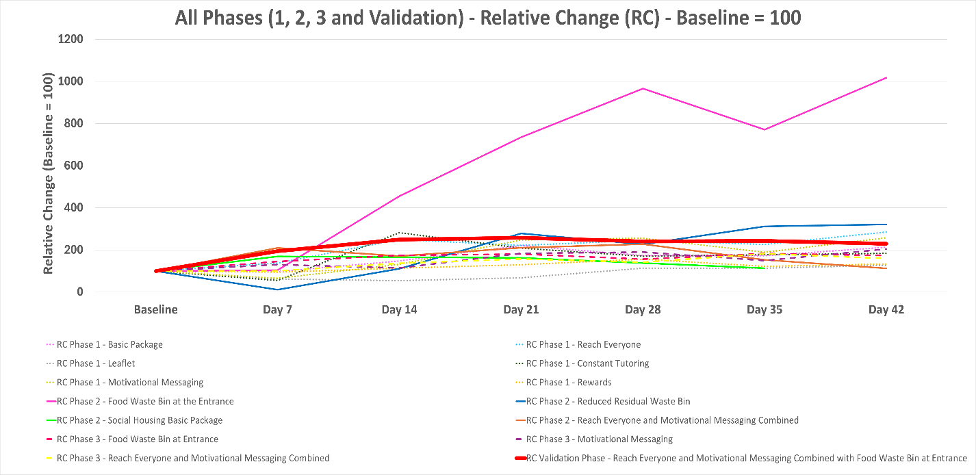

Slide 15
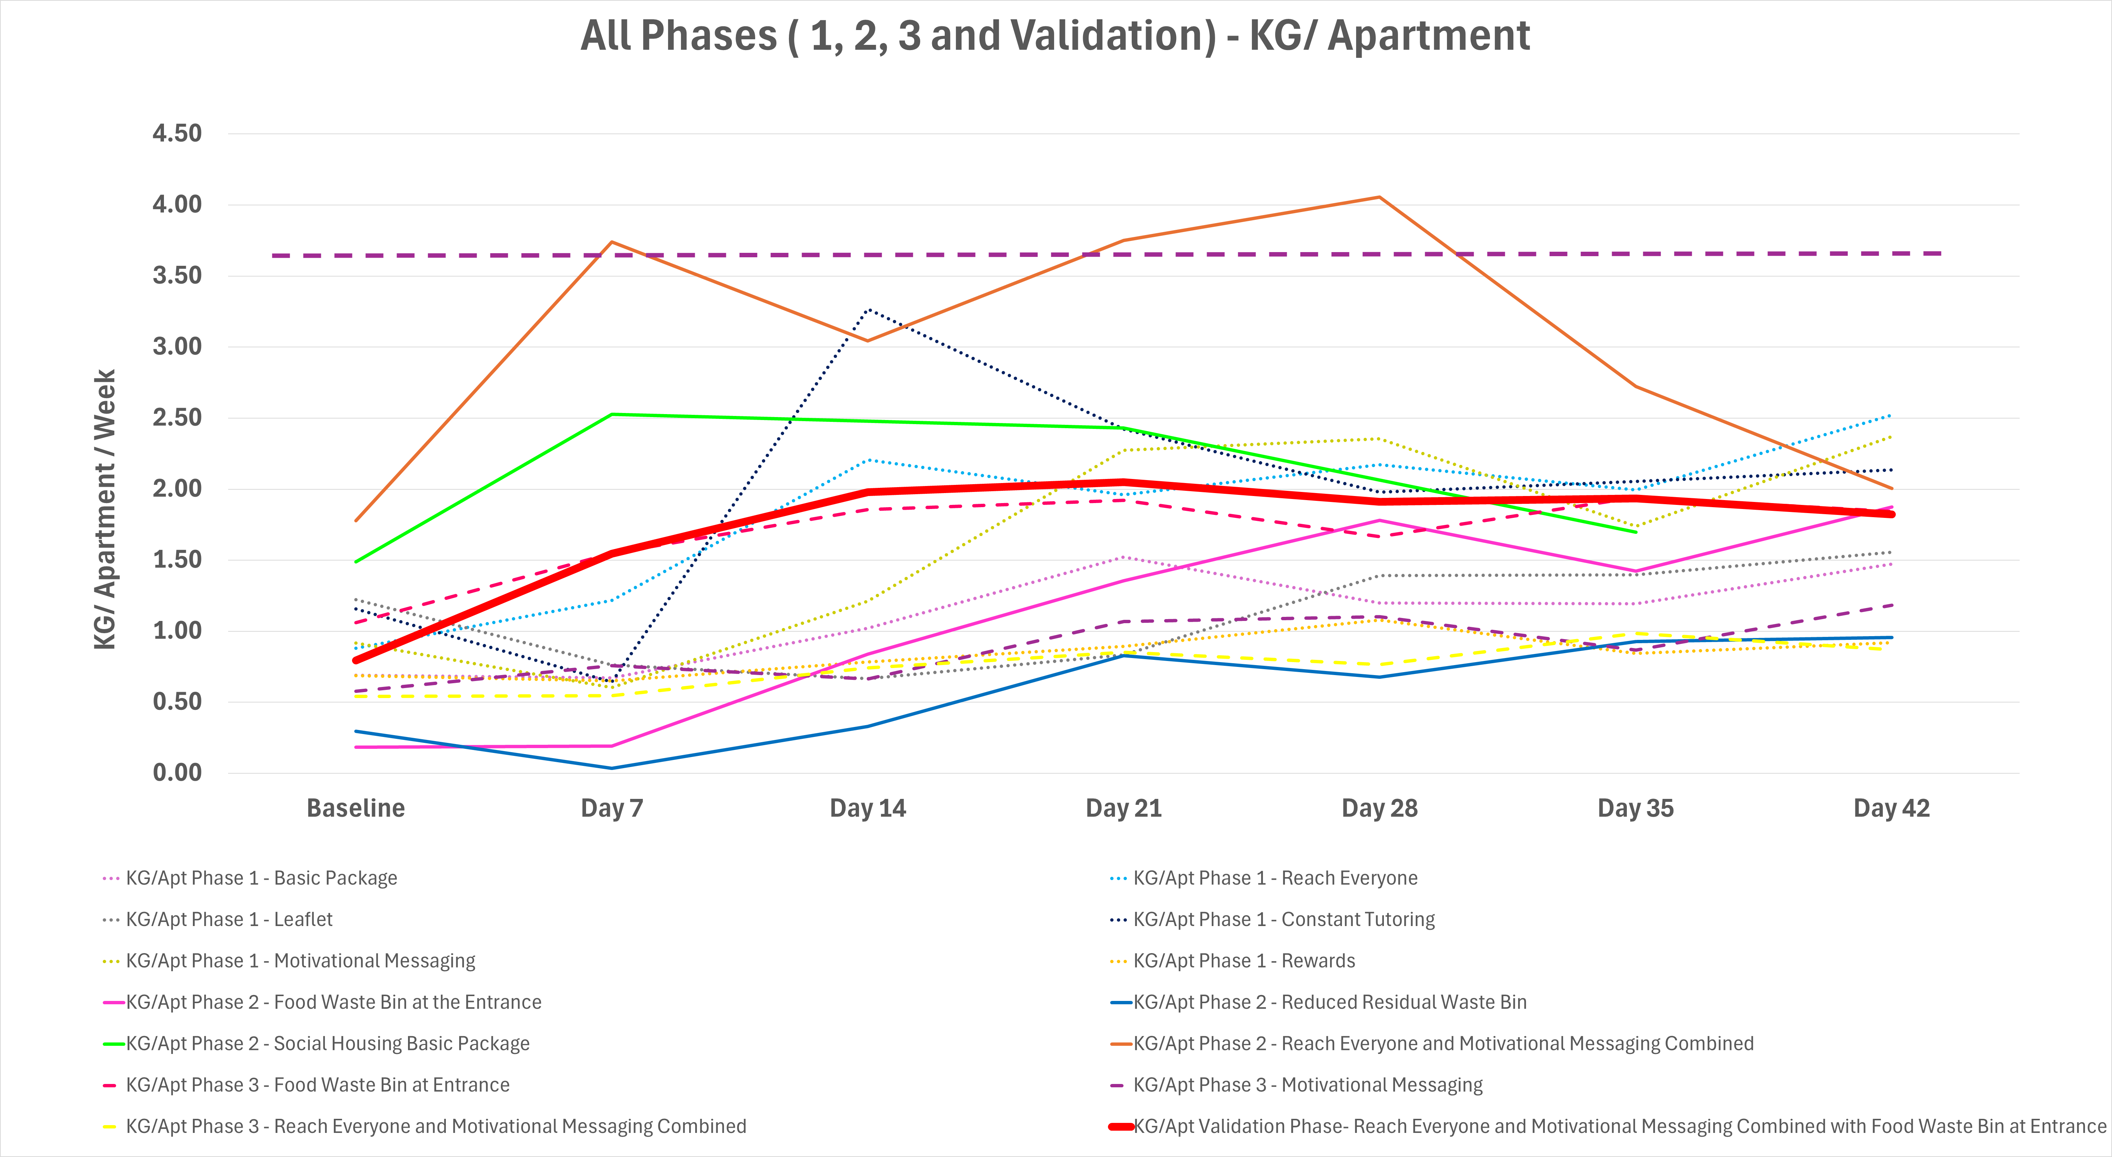
Key Takeaways:
High variability at the commencement of trials (From approx. 0.2kg/apartment/week up to 2 kg/apartment/week. This variability reduces as the trials progress. Many apartments are now between approx. 1.5kg/apartment/week and 2.5kg/apartment/week. There is an overall behavioural change. Apartment households that previously did not participate in food waste recycling are now participating.
World leader in food waste recycling, Milan, Italy. Recycling at a rate of approx. 3.6 kg/apartment/week In comparison, Validation Phase: Rose from a baseline of 0.79 kg/apartment/week to an average of 1.93 kg/apartment/week.

Slide 16
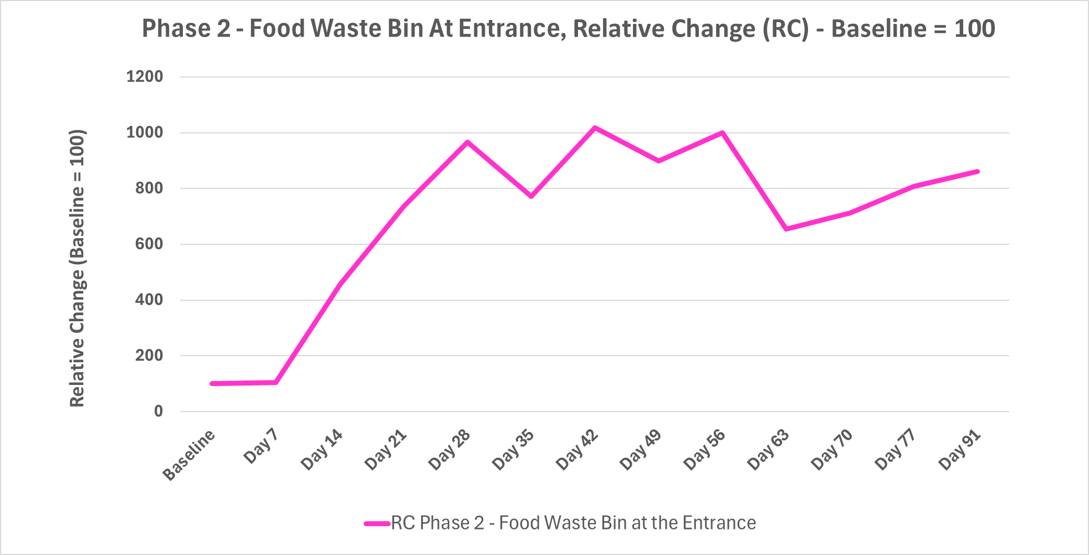
Continuous Supply of Compostable Bin Liners
Key Takeaways:
Because we extended this trial over the summer, we noticed that when the supply of compostable bin liners was depleted, food waste recycling dipped. We provided an additional supply to the residents, the food waste recycling increased again.
Prior to Day 70 weighing, additional compostable bin liners were provided to residents.

Slide 17
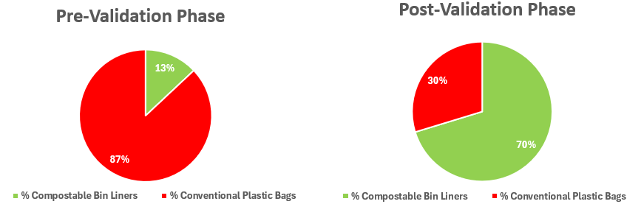
Contamination
Phase | Trial | PRE Trial Waste Characterisation | POST Trial Waste Characterisation
1 | Reach Everyone | 3.2% | 3.0%
1 | Motivational Messaging | 1.5% | 1.2%
1 | Constant Tutoring | 5.9% | 4.3%
1 | Basic Package | 6.8% | 1.1%
1 | Rewards | 3.5% | 0.0%
1 | Educational Leaflet | 5.1% | 1.9%
2 | Food Waste Bin at the Entrance | 3.0% | 0.4%
2 | Social Housing Basic Package | 6.1% | 2.2%
2 | Reduced Residual Waste Bin | 2.2% | 1.7%
Validation | Reach Everyone and Motivational Messaging Combined with Food Waste Bin at Entrance | 6.0% | 1.4%
The percentage of conventional plastic bags found in both the pre validation phase and post validation phase

Slide 18
Conclusions

Slide 19
Conclusions from Trials
Item | Conclusion
Recommendation 1 | Considering not all apartments will have the capability to put a food waste bin near their entrance We recommend applying the combined principles of Reach everyone and Nudging them with motivational communications as a standard method to improve food waste recycling rates in apartment buildings For maximum food waste collection, we recommend, in addition, having a food waste bin near the apartment block entrance where possible.
Recommendation 2 | In addition, it has also been observed that running out of compostable bin liners leads to a dip in food waste recycling participation. Compostable bin liners also contribute to less contaminated food waste recycling. We recommend continuous supply of compostable bin liners (by property manager, most likely)

Slide 20
Implications of Findings for Ireland
Key Takeaways:
Apartments & Food Waste: National Outlook 3,381 tonnes of food waste collected from apartments in 2023 With the proposed nudging interventions implemented nationally: By 2030, approx. 42,000 tonnes of food waste could be collected from apartments annually. At an estimated 1.4% contamination rate.
This represents a 1.26% contribution toward Ireland’s municipal solid waste recycling target. These simple nudging techniques can have a significant effect.

Slide 21
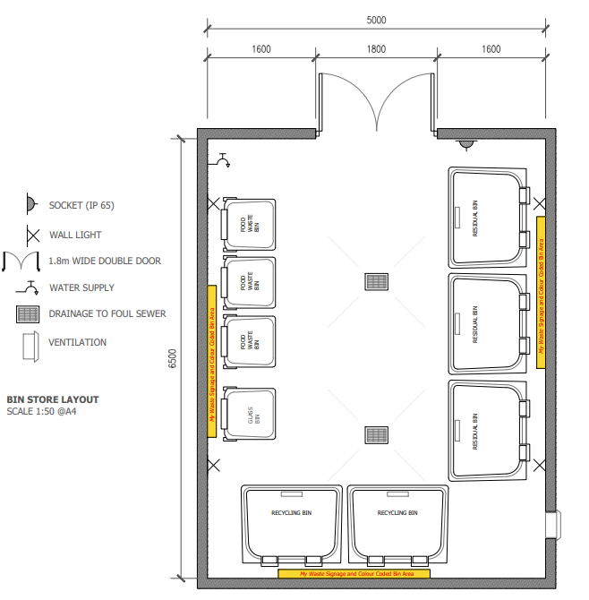
Apartment Shed Design for Piloting
Design to be Piloted- based on 60 apartments
A key criterion to make the waste area convenient for residents is that is located within 20-30 metres of the entrance of the apartment block
1 x 140 litre bin for food waste per 20 apartments
3 x 1100 litre bin for recycling – paper, plastic etc
2 x 1100 litre bin for residual
1 x 140 litre glass bin
Water tap
Ventilation
Floor draining
No lip at door
Secure access – key or fob
Signs on walls for bin
Bright, light & painted walls

Slide 22

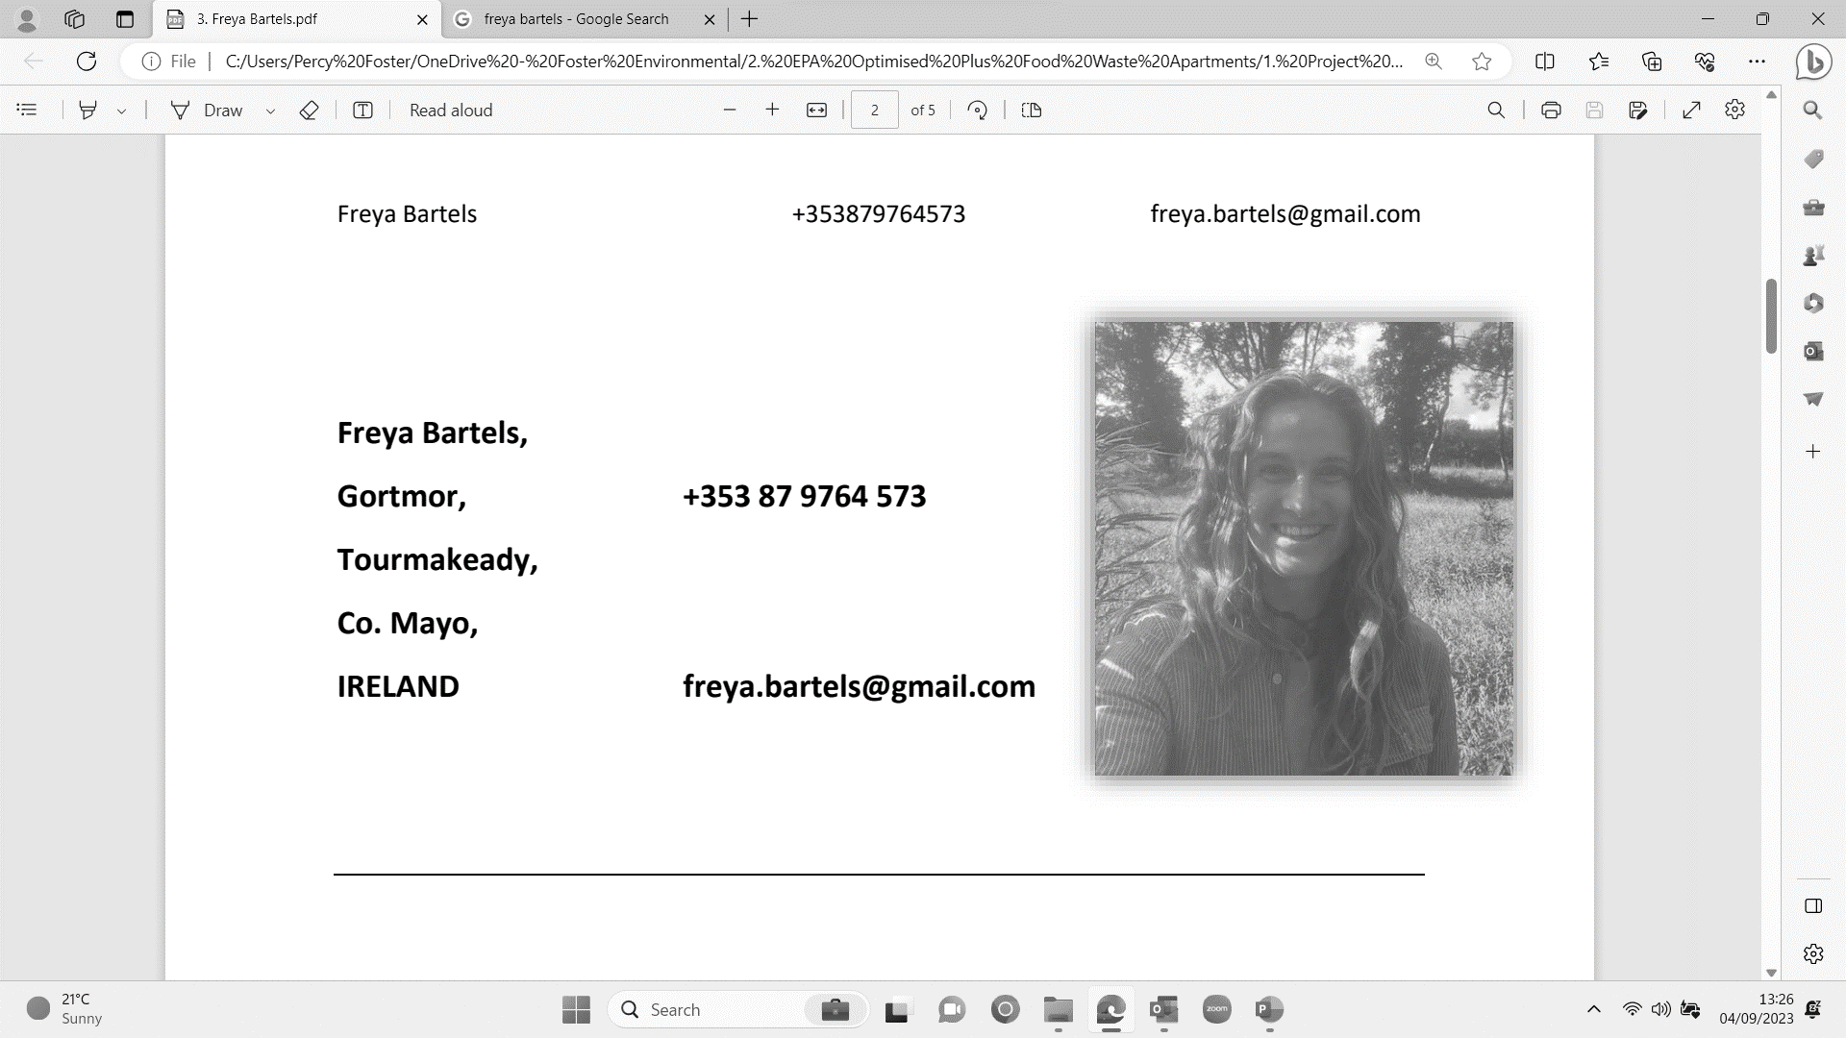



Research Team
The Project Team
Percy Foster
Foster Environmental
Freya Bartels
Foster Environmental
Celia Cremin
Foster Environmental
Enzo Favoino
Scuola Agraria del Parco di Monza
Michele Giavini
ARS

Slide 23




Thanks to Sponsors
percy@foster.ie
www.foster.ie
This project is Joint funded under the EPA Research Programme 2021-2030. The EPA Research Programme is a Government of Ireland initiative funded by the Department of the Environment, Climate and Communications

